Slide 1
Report 09/01/2020
P. Hacker

Slide 2
Previously: Geometry Sensitivity Study
radiation feedback controlled discharge 20181010.032 shows transitions from no-stationary radiation states between 90%-100% radiation fraction
with STRAHL simulate radiation profiles, given the electron temperature and density at distinct radiation fraction levels to investigate intrinsic (oxygen and carbon) impurity radiation
STRAHL profiles show asymmetric chordal profiles after forward calculation with emissivity matrices, though being intrinsicly symmetric

Slide 3
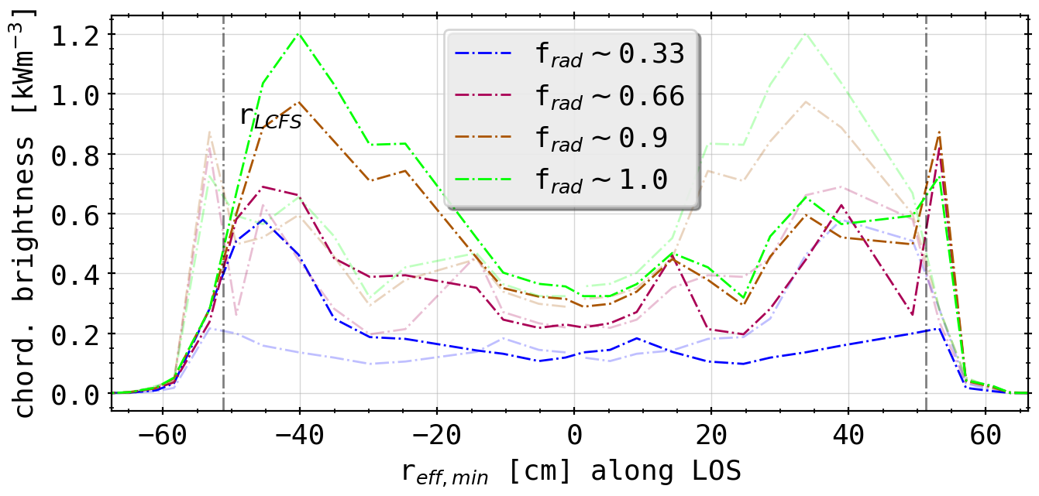
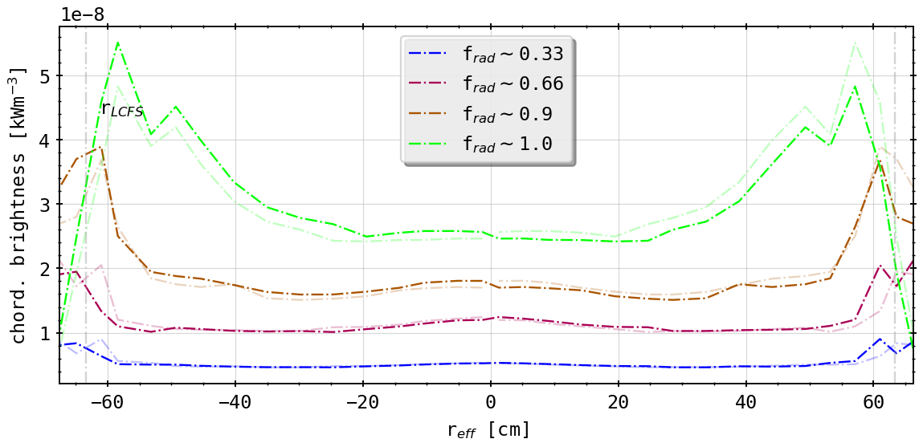
Previously: Geometry Sensitivity Study
STRAHL profiles show asymmetric chordal profiles after forward calculation with emissivity matrices, though being intrinsicly symmetric
mirrored profile
(chordal profile 20181010.032, HBCm)
(chordal profile from STRAHL, HBCm)

Slide 4
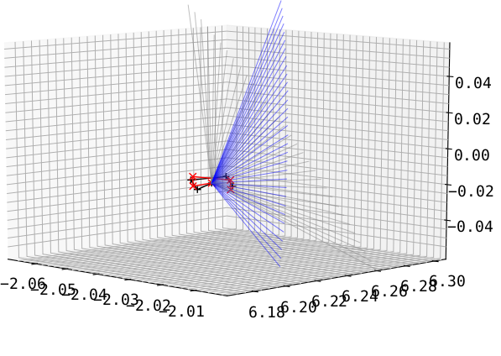
Results: Tilting the Detector Fan Up/Down
deviance in STRAHL possibly results of intrinsic geometry
ALSO: testing more effects that could change the intrinsic geometry, which can not be analysed
e.g.: take symmetric arrays and tilt the entire fan including the aperture poloidally (grey to blue and black to red)
HBCm
(results with aperture change included)

Slide 5
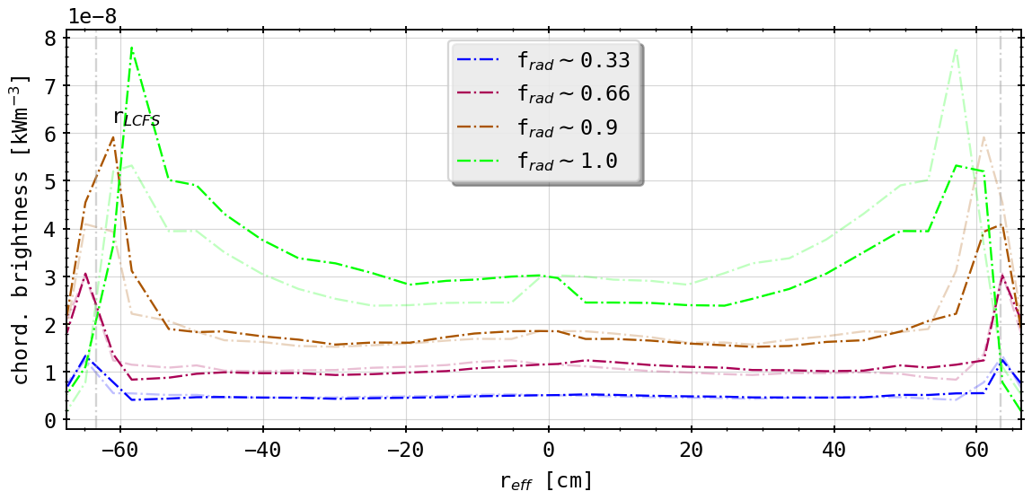
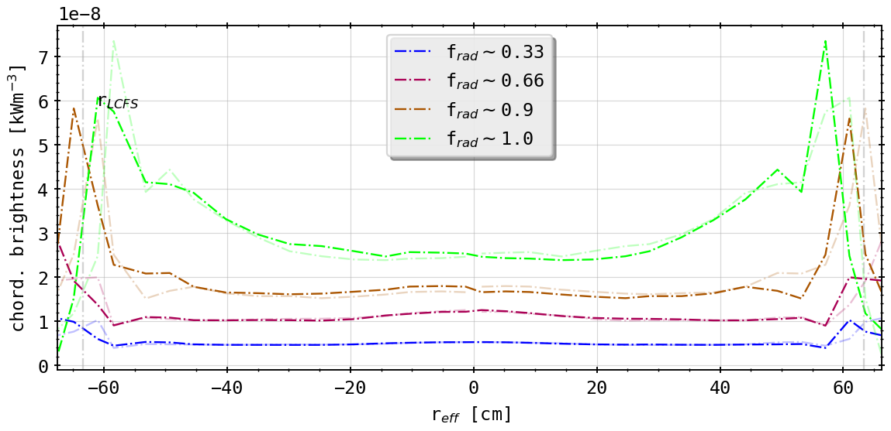
Results: Different Tilts from As-Built Geometry
(0.5° tilt (down))
(-0.5° tilt (up))
asymmetry switchable/changed around
alignment better now upside (tilt down!)
radial movement as before and in original

Slide 6
First Summary
geometry sensitivity study yields great insight on how the camera setup and errors effect forward calculations
results show that variety and possibly a combination of measurement and intrinsic geometry errors are responsible for further asymmetries in results
Is the camera geometry adequate to resolve radial shifts in 2D from STRAHL?
need 2D tomography of radiation distribution
benchmark Minimum Fischer Regularization method for 2D inversion using a variety of phantom radiation profiles with various distinct or mixed characteristics

Slide 7
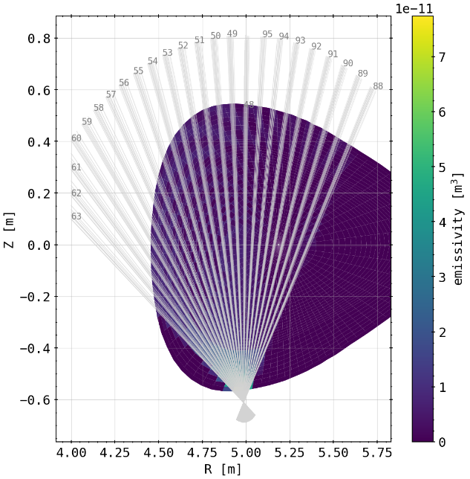
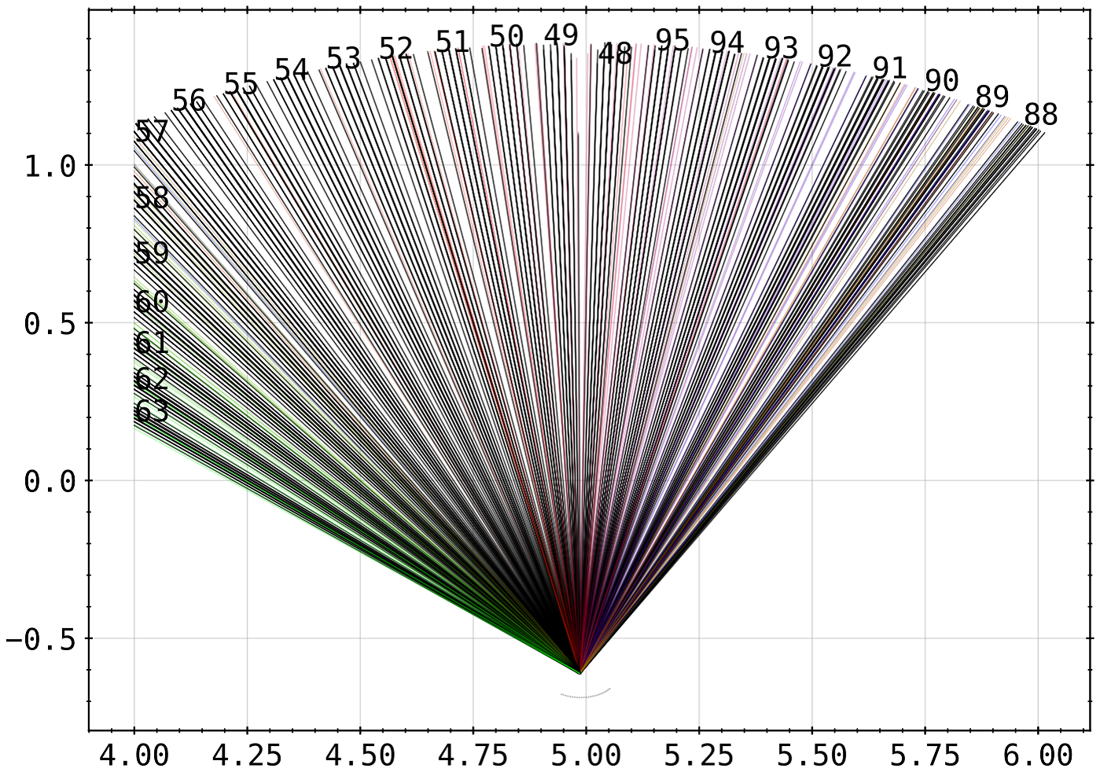
Reference to Previous Results: 2D Projection
previous investigations into surrogate profile benchmarks made based off an attempt to treat lines of sight and sensitivity matrices geometry in 2D, e.g. in the plane of the camera
however: errors made in treatment of (x,y,z) in plane of camera
new approach: finding polar coordinates in camera plane and find fluxsurface geometry in each individual camera location
cut of camera plane with vectors of fluxsurfaces in successive toroidal positions
(bad coverage of 64 individual center lines of sight from interpolated detector and pinhole geometry)

Slide 8
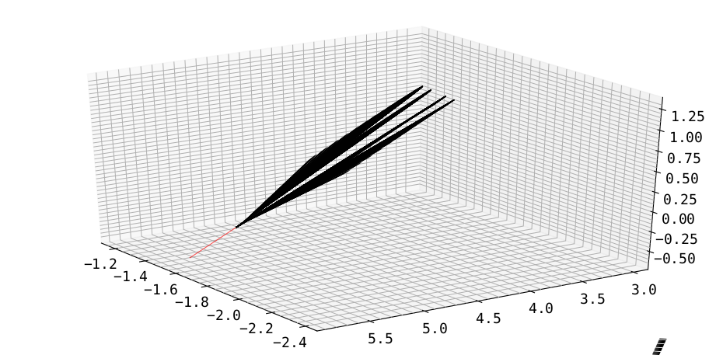
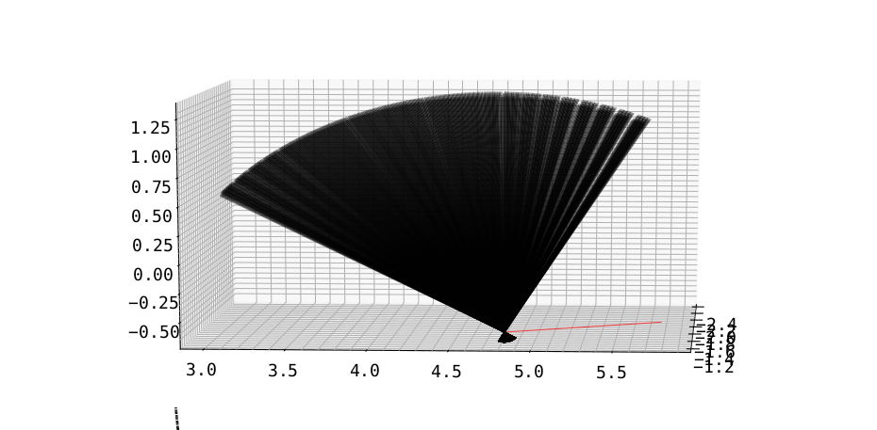
Reference to Previous Results: 2D Projection
projection into ‘2D’ by treating the LoS in respective camera plane through conversion into polar coordinates
create intersection vector between camera and xy-plane, then find angle inbetween LoS and intersection
take out-of-plane angle from camera and LoS into account for ‘correct’ line length measurement when looking at cell intersections
(VBCr with intersection line to xy-plane)

Slide 9
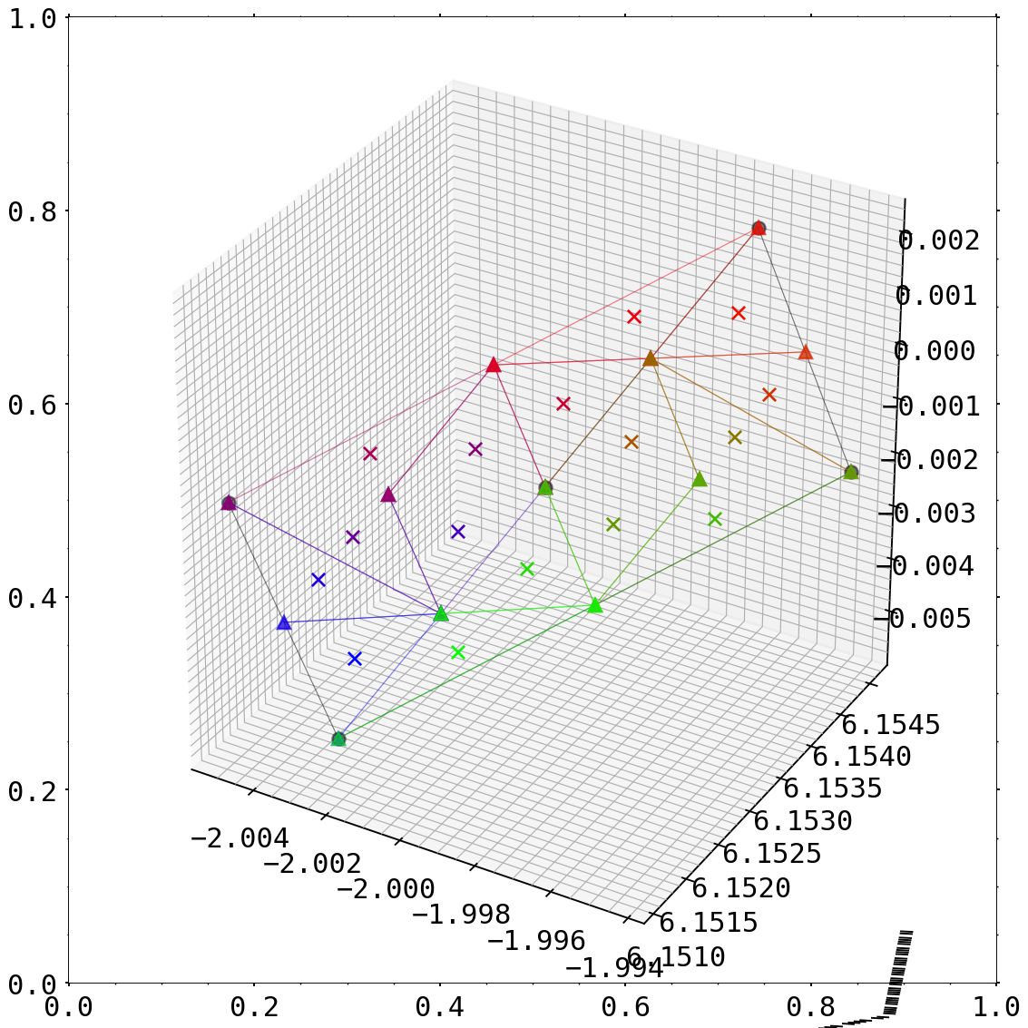
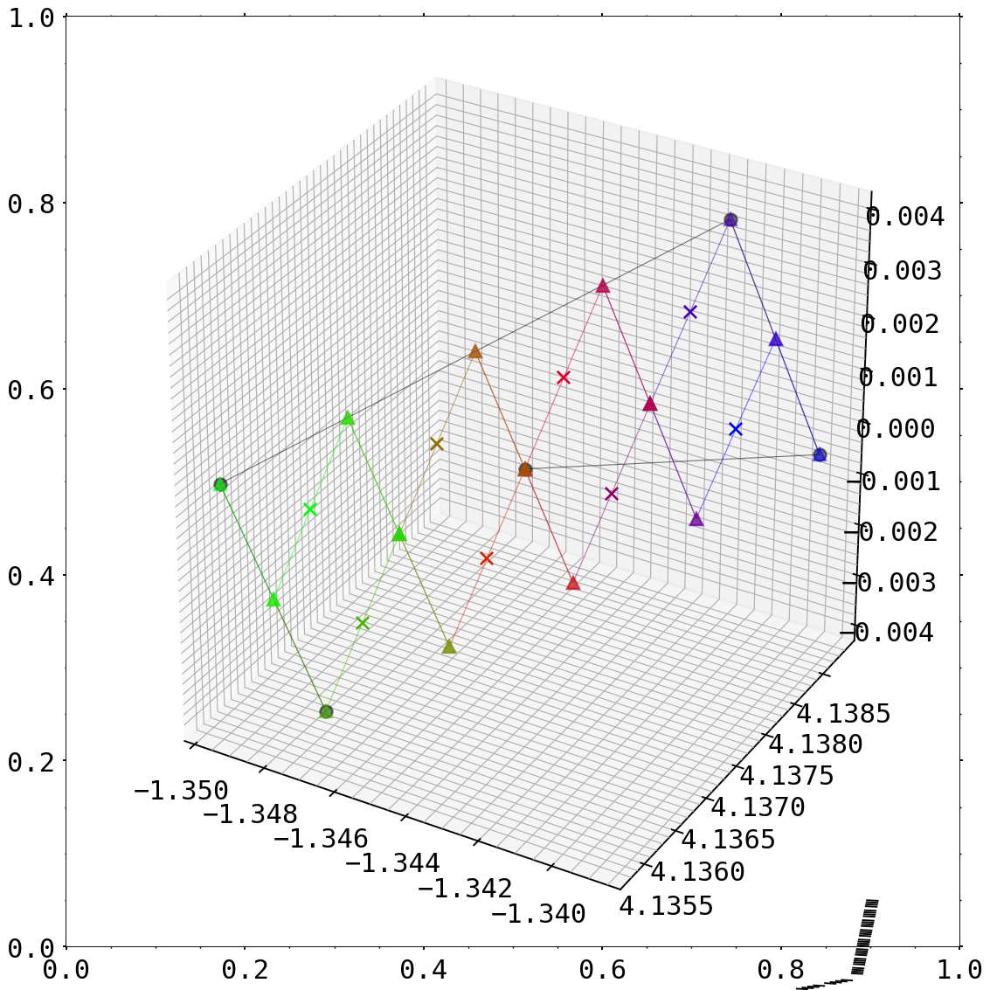
Reference to Previous Results: 2D Projection
now also two modes of interpolation of detector/pinhole applied
triangulation
square

Slide 10
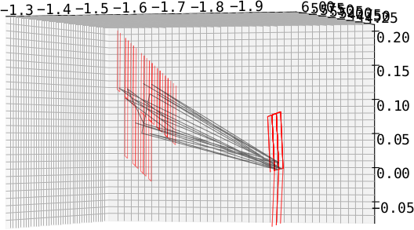
Reference to Previous Results: 2D Projection
3D line of sight cone projection through plasma shell with center and full volume
16 lines for the cone by projection of detector corners through aperture corners

Slide 11
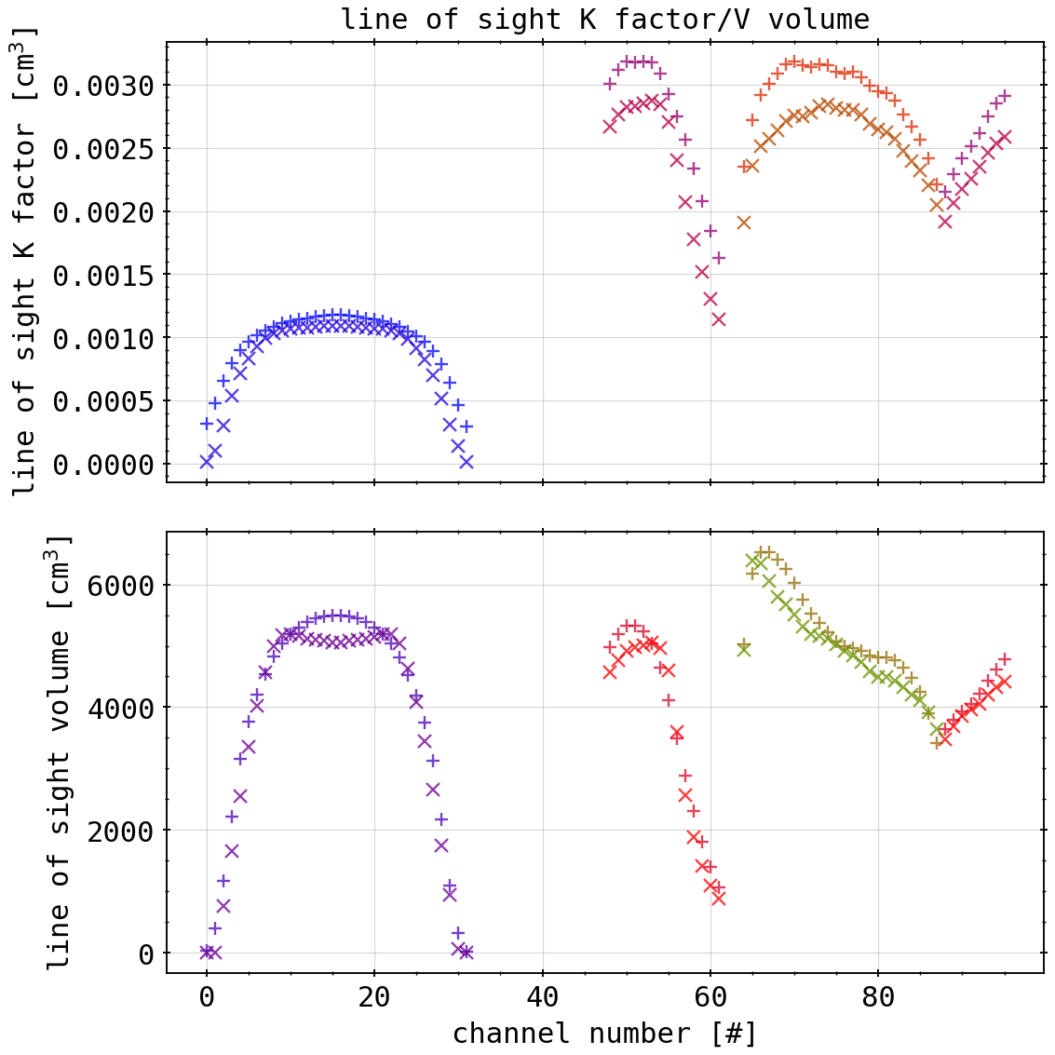
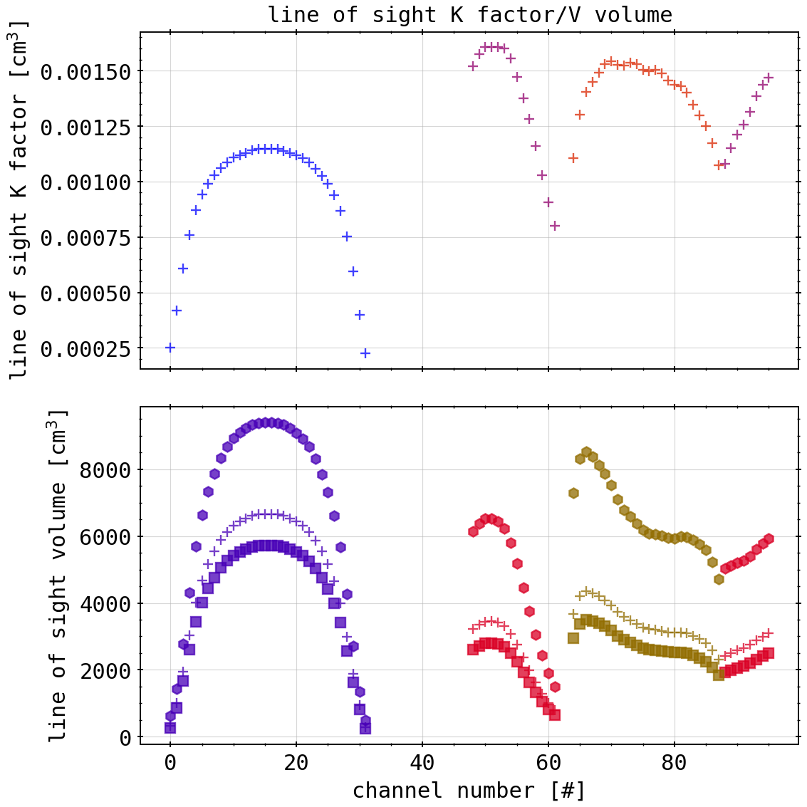
Reference to Previous Results: 2D Projection
3D line of sight cone projection through plasma shell with center and full volume
16 lines for the cone by projection of detector corners through aperture corners
reference
calculated
full cone
center + 0.1 * full
center cone

Slide 12
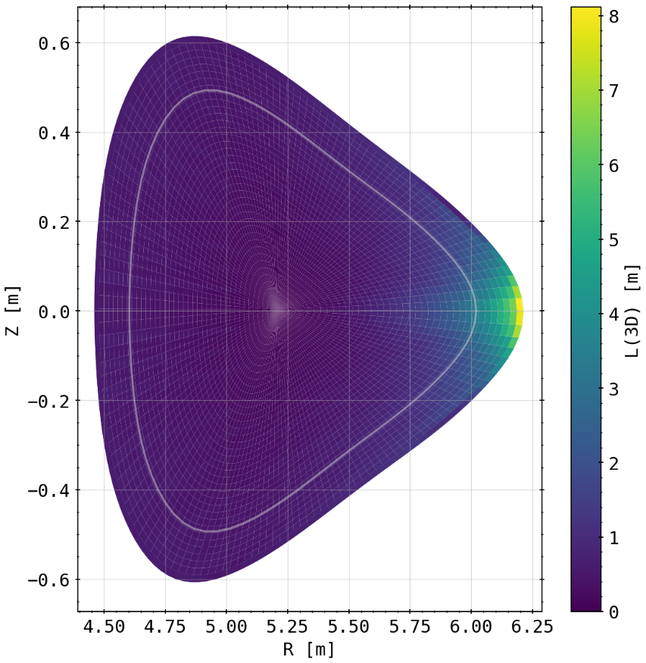

Reference to Previous Results: 2D Projection
Applicable? If so, to what degree resemblance to real 3D geometry?
3D is result of condensing toroidal cells into plane of camera, 2D is directly only from plane with out-of-plane fix for length
smaller maximum
3D line section in cells
2D line section in cells
asymmetry

Slide 13
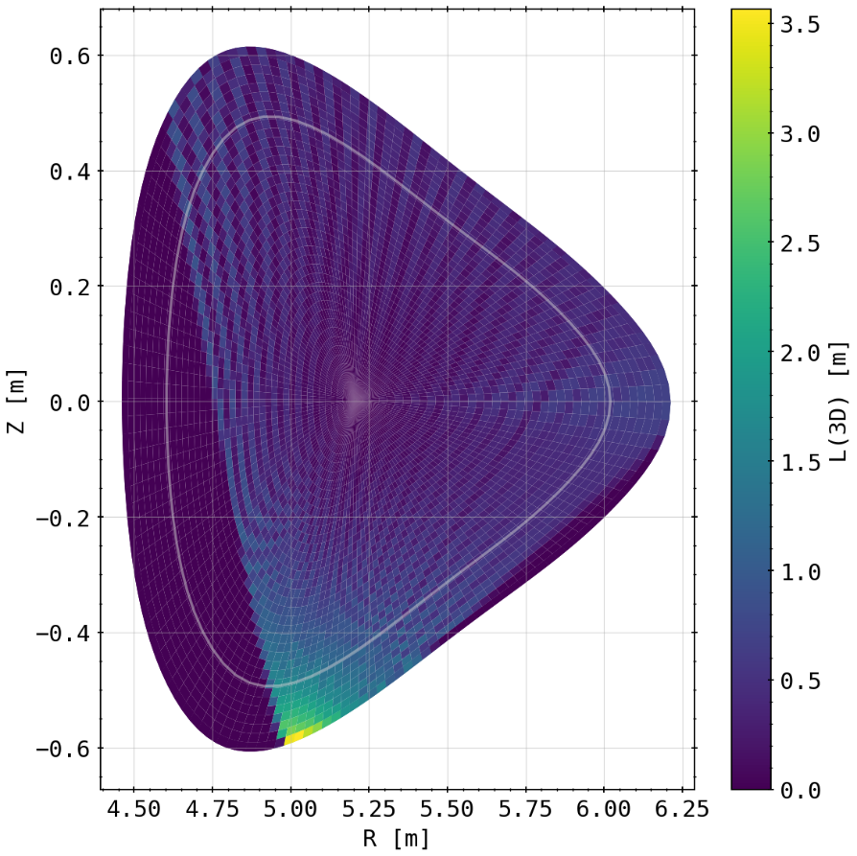
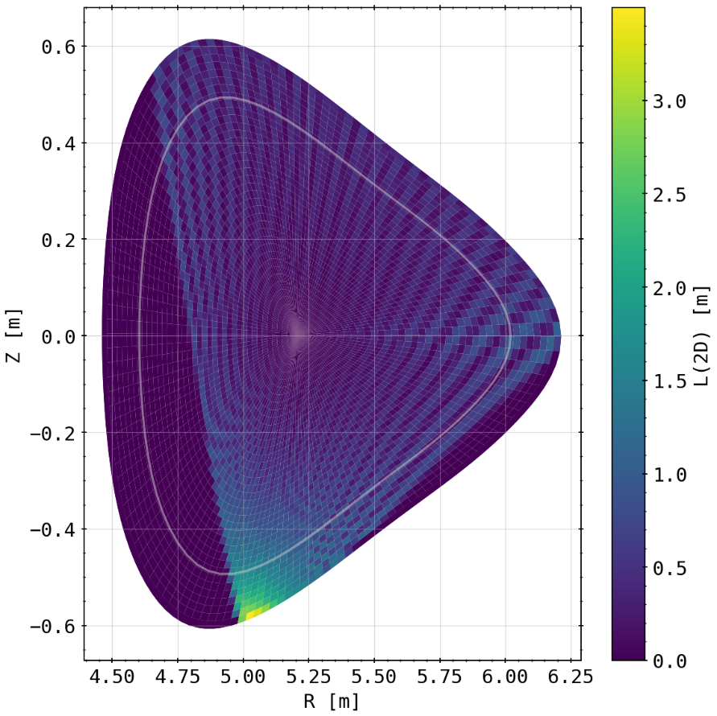
Reference to Previous Results: 2D Projection
Applicable? If so, to what degree resemblance to real 3D geometry?
3D is result of condensing toroidal cells into plane of camera, 2D is directly only from plane with out of plane fix for length
3D line section in cells
2D line section in cells
coverage

Slide 14
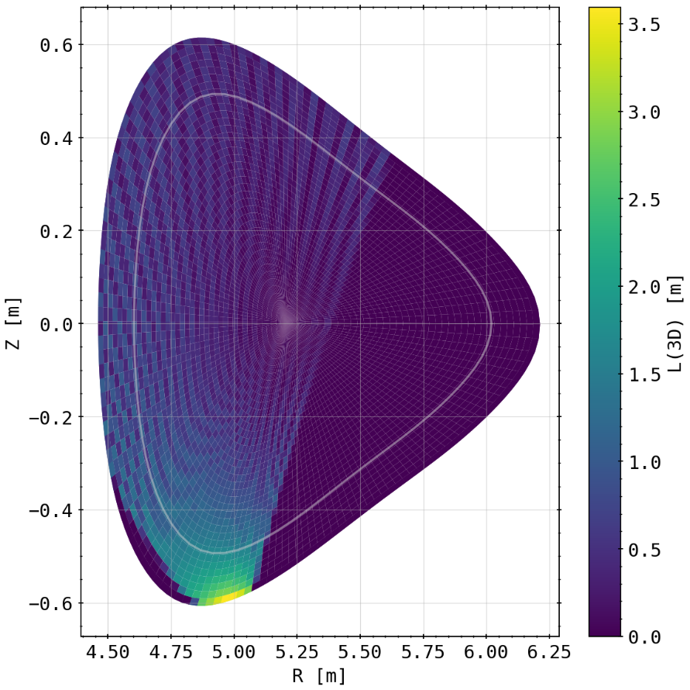
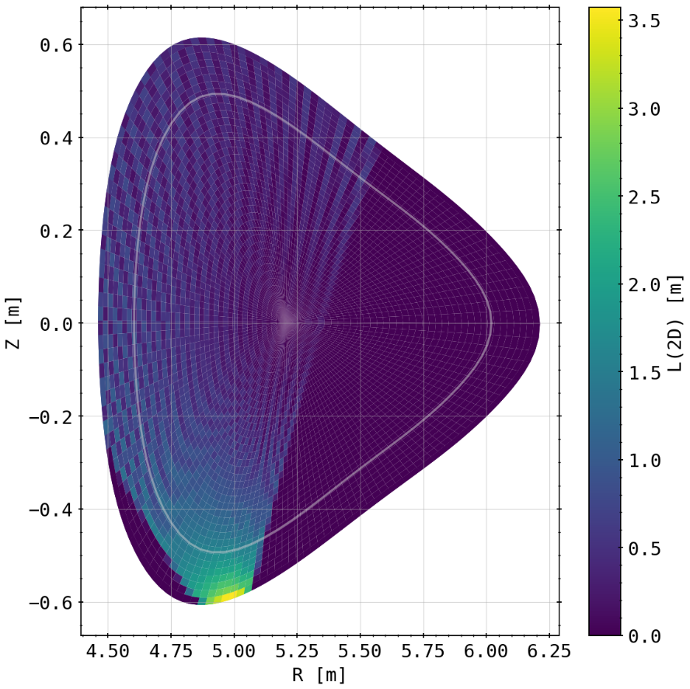
Reference to Previous Results: 2D Projection
Applicable? If so, to what degree resemblance to real 3D geometry?
3D is result of condensing toroidal cells into plane of camera, 2D is directly only from plane with out of plane fix for length
3D line section in cells
2D line section in cells

Slide 15
Reference to Previous Results: 2D Projection
Applicable? If so, to what degree resemblance to real 3D geometry?
3D is result of condensing toroidal cells into plane of camera, 2D is directly only from plane with out of plane fix for length
CONCLUSION: 2D projection possible, does not entirely represent the full 3D setup of the Bolometry system at W7-X
for a more planar line of sight cone projection might be applicable, has to be treated in camera plane
biggest deviance from coverage of pixel areas (or not) which can not be accounted for in 2D
next: results from 3D calculations

Slide 16
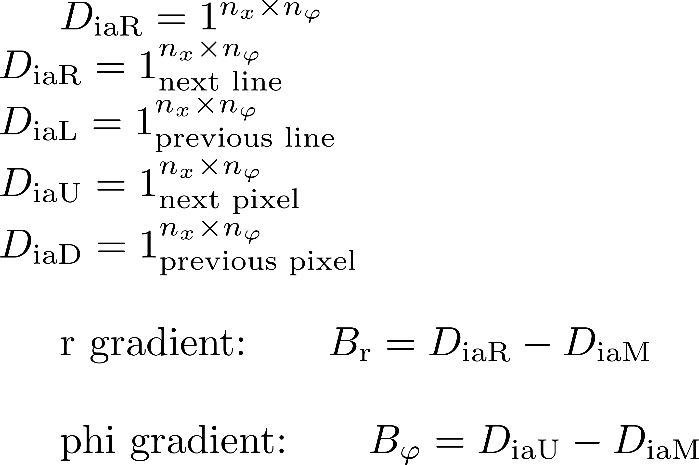
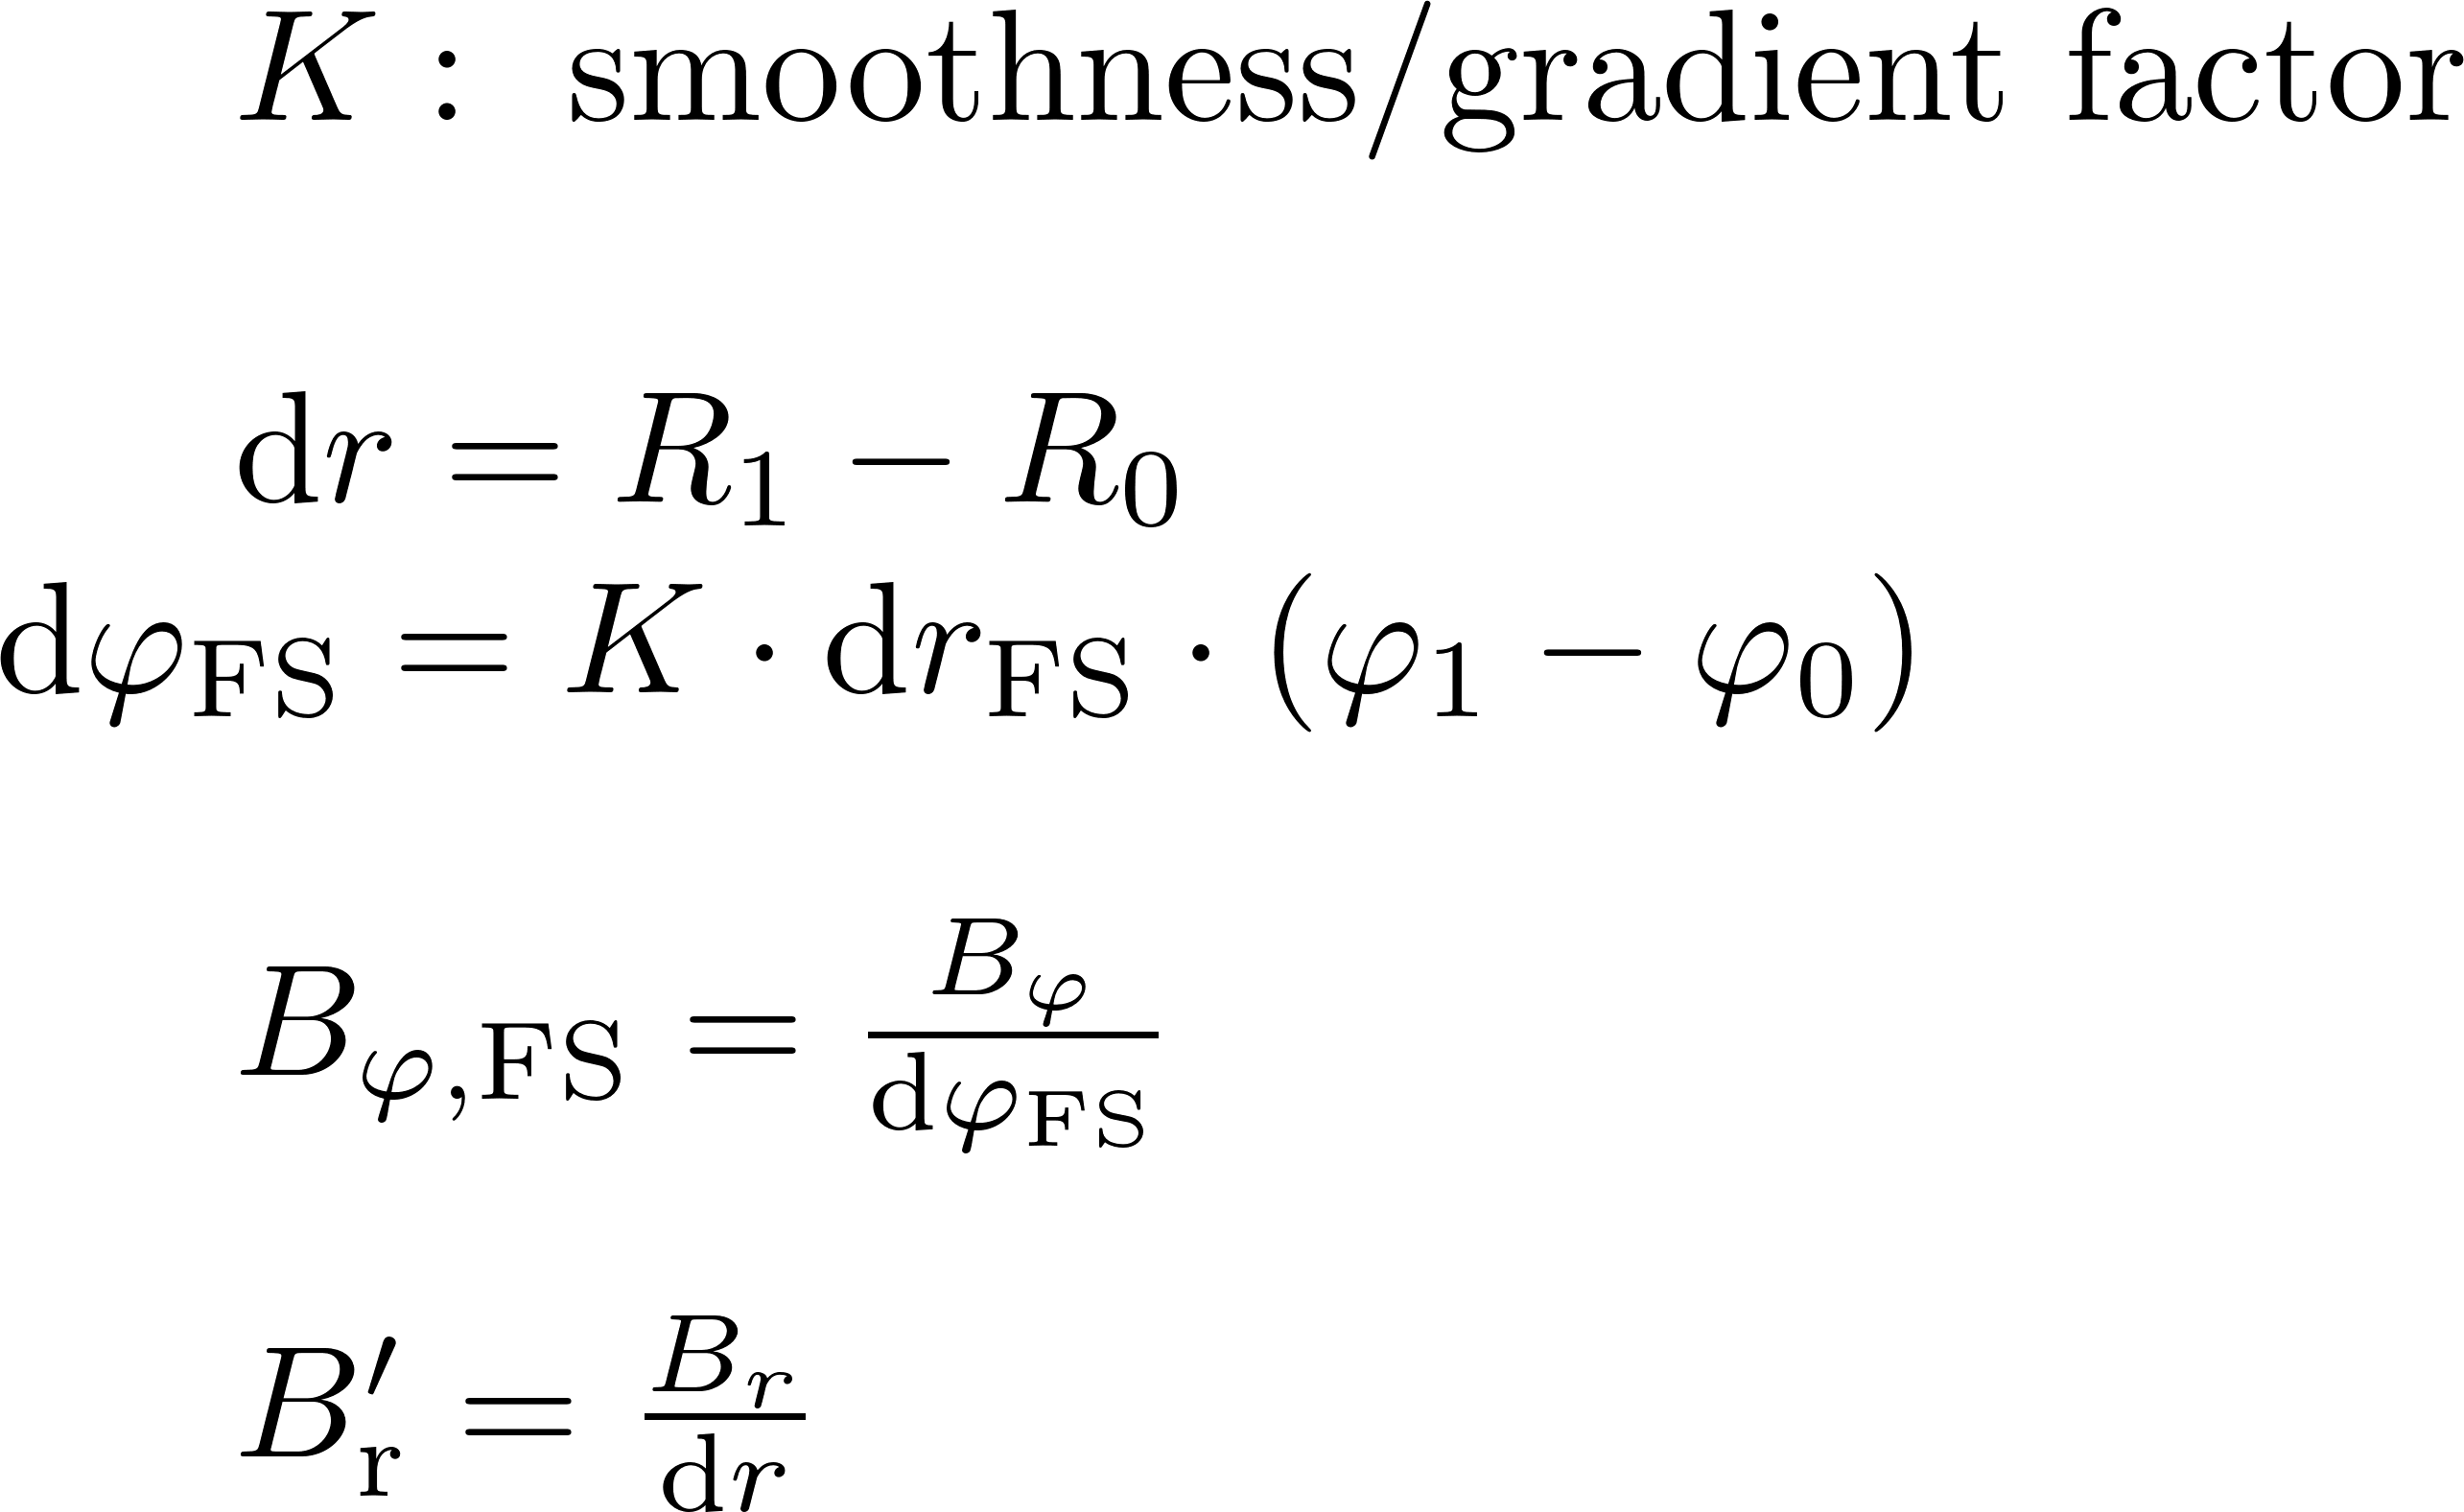
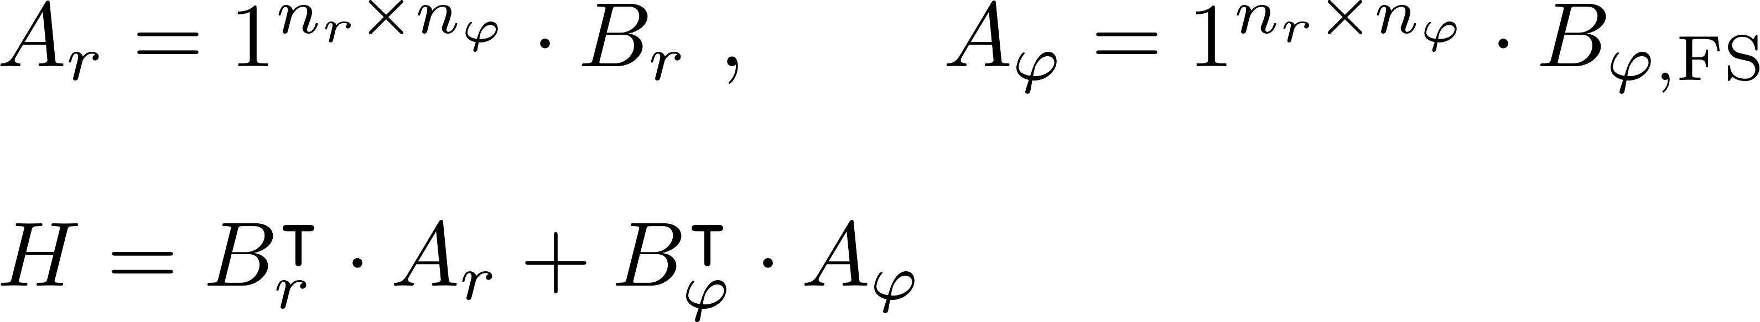
Phantom Test: Poloidal Gradient Factor

Slide 17
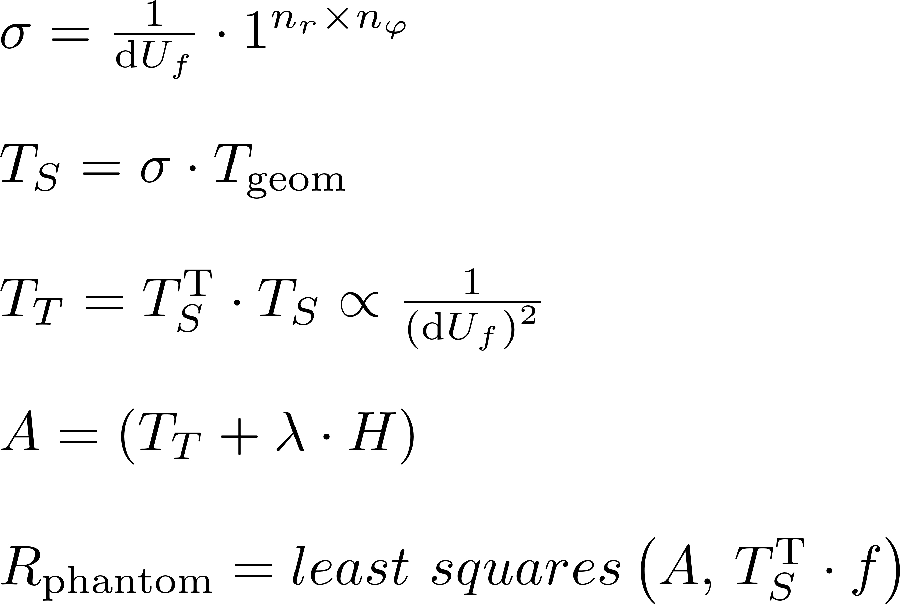
Phantom Test: Poloidal Gradient Factor

Slide 18
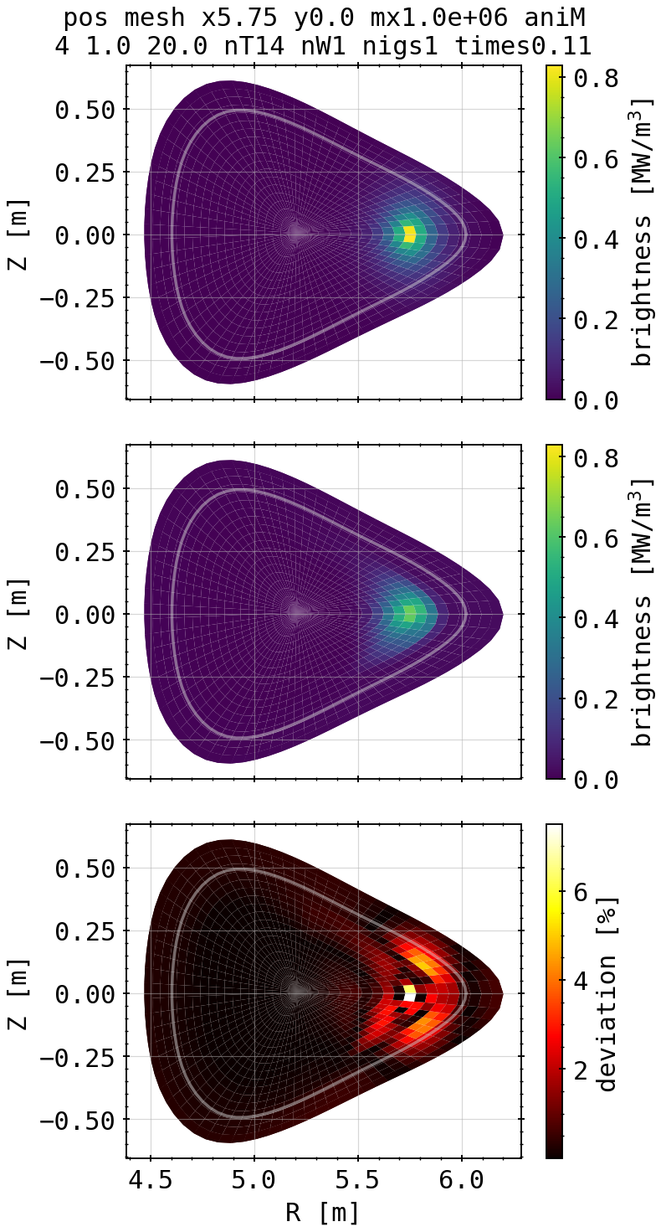
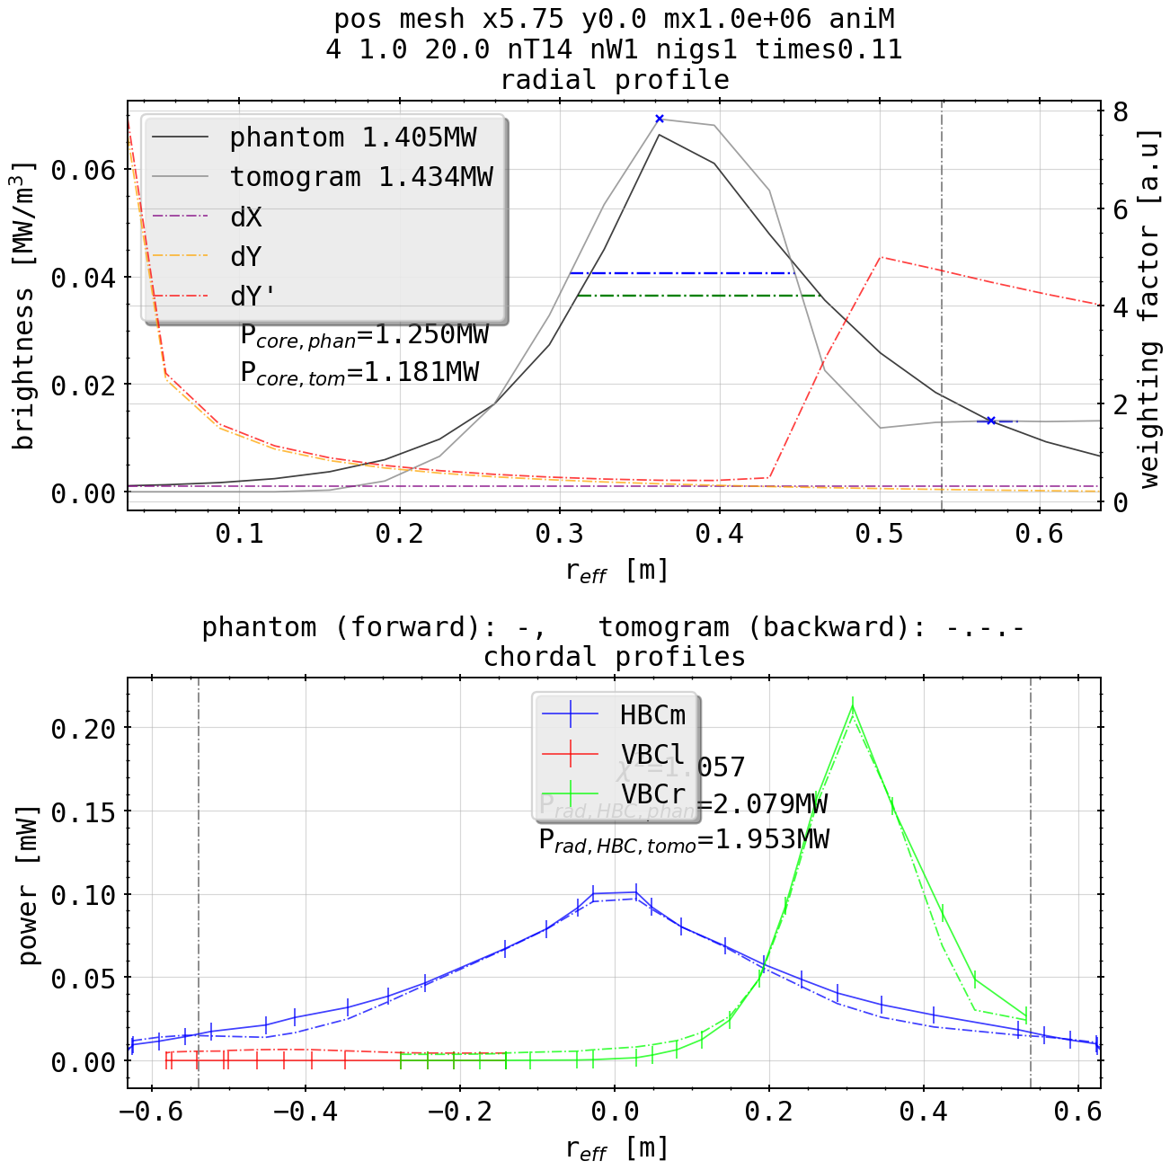
Phantom Test: Single Spot Off-Center
general remarks
(phantom)
radiation power calculated as usual like in experiments
total & core power estimated by hollow cylinders of fluxsurfaces from radial profile (unit errors, fix needed)
X² measurement for congruence of forward and backward profiles
(1.0 optimum)
(tomogram)

Slide 19
Phantom Test: Single Spot Off-Center
general remarks
(phantom)
radial profile peak localization and width of distribution
X² quality does not necessarily equal best tomogram, hence the need for 2D relative deviation as measure to find best fit
deviation percentage relative to area of cell & domain
(tomogram)

Slide 20
Phantom Test: Single Spot Off-Center
general remarks
(phantom)
smoothing along fluxsurfaces, according to weighting of derivatives
dX: gradient in radial direction; does not change across inversion domain
dY: poloidal gradient length scale; high at center/inside confinement area, small outside
dY’: weighted poloidal gradient with input profile
(tomogram)

Slide 21
Phantom Test: Single Spot Off-Center
on the surrogate
(phantom)
very unrealistic, hard to reconstruct surrogate
radial positioning good if K profile dialed
poloidal smoothing at minimum, smaller values yield artifacts or redistribution to different areas of domain
calculated powers match
(tomogram)

Slide 22
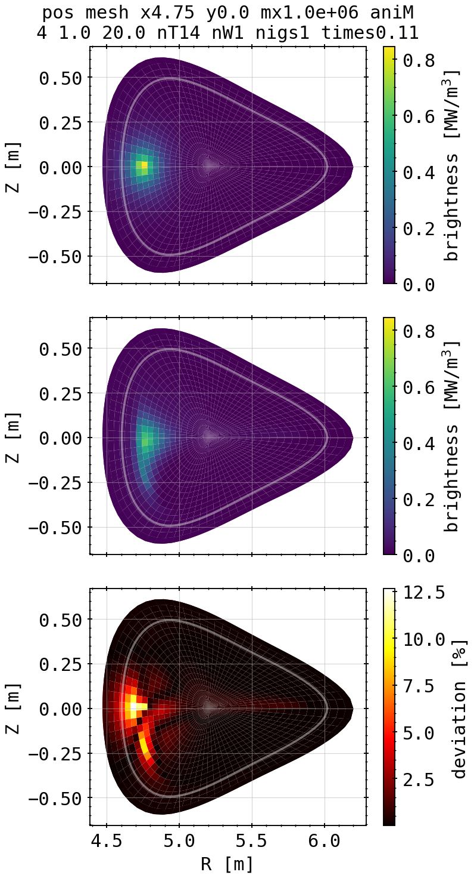
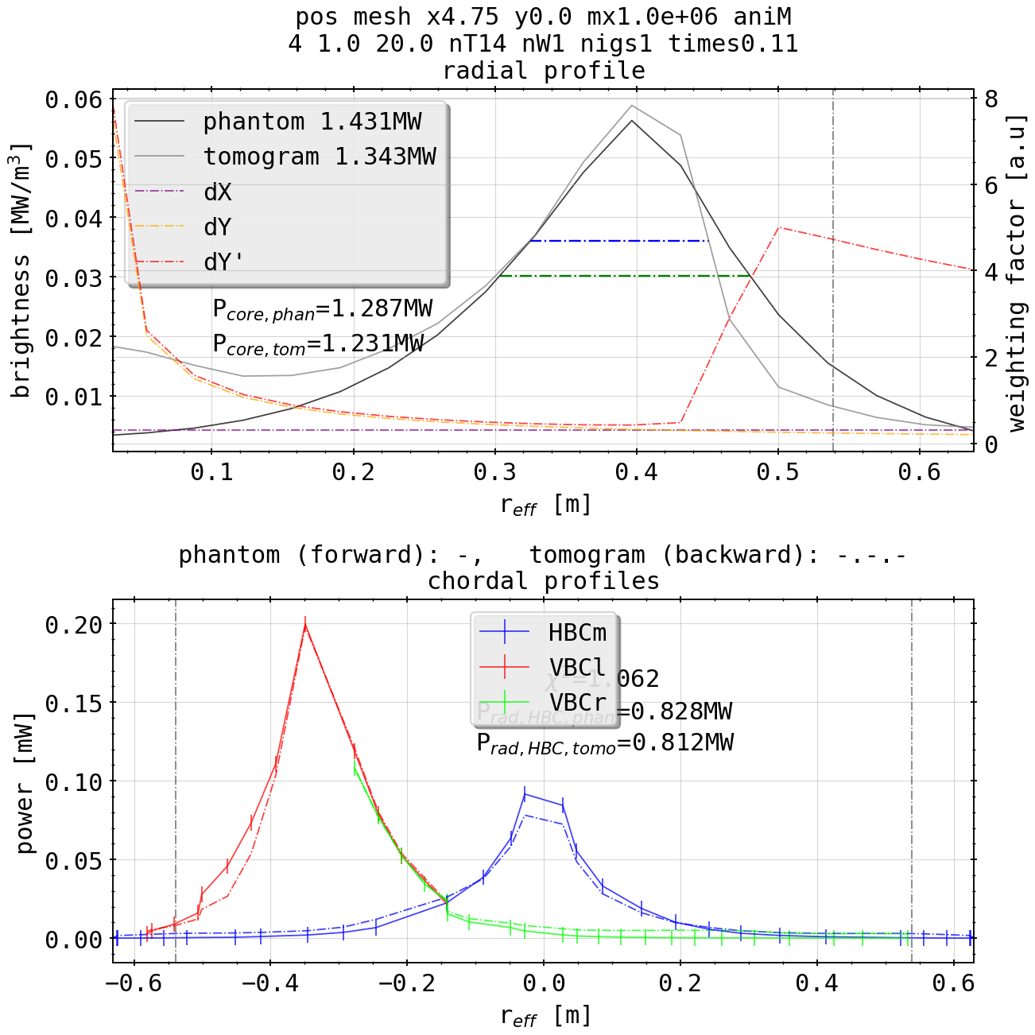
Phantom Test: Single Spot Off-Center
radial position equally accurate, reflected as well in radial profile
poloidal smoothing worse, suspect to tangential lines of sight from vertical camera arrays
extrapolated radiation power loss from chordal profiles ~80-100% lower
absorption of HBCm smaller and 2x the 2D error
(phantom)
(tomogram)

Slide 23
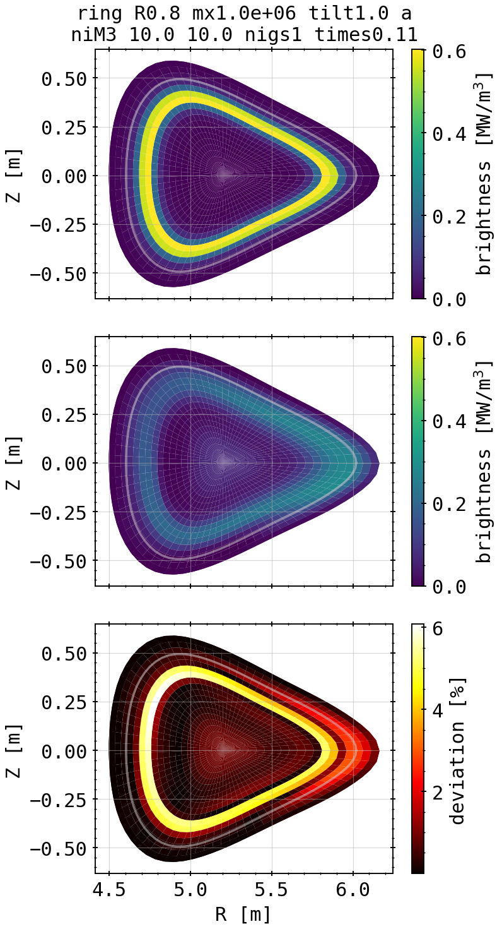
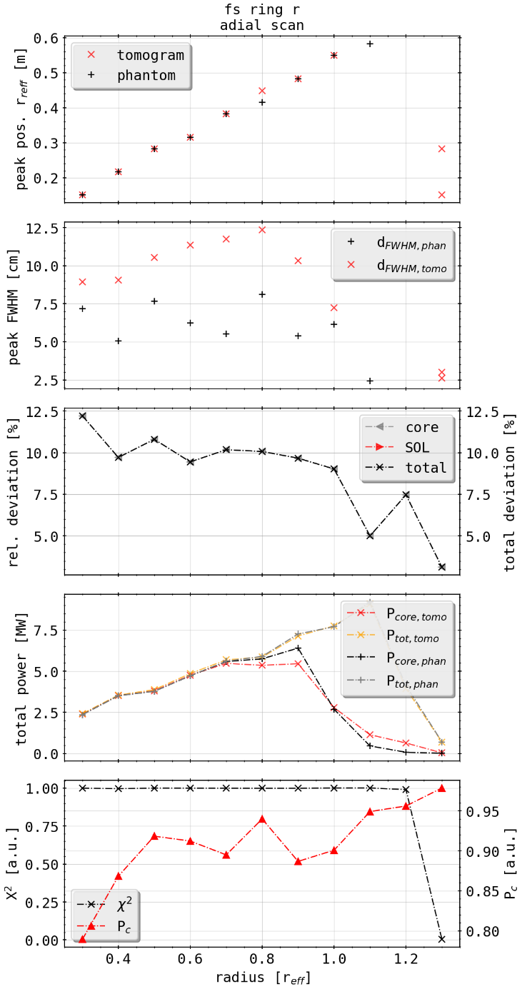
Phantom Test: Single Bright Ring
(phantom)
scanning over the radial position of the ring, e.g. in units of the minor radius
radial peak location matched accurately, although peak/profile shape distorted in radial direction
X² fits perfectly until degeneration when only edge of domain is bright
incorporated Pearson coefficient measures cross correlation between 2D profiles of phantom and tomogram, i.e. better number for accuracy
X² optimum is not matched with neither Pearson coeff. or 2D deviance
(tomogram)

Slide 24
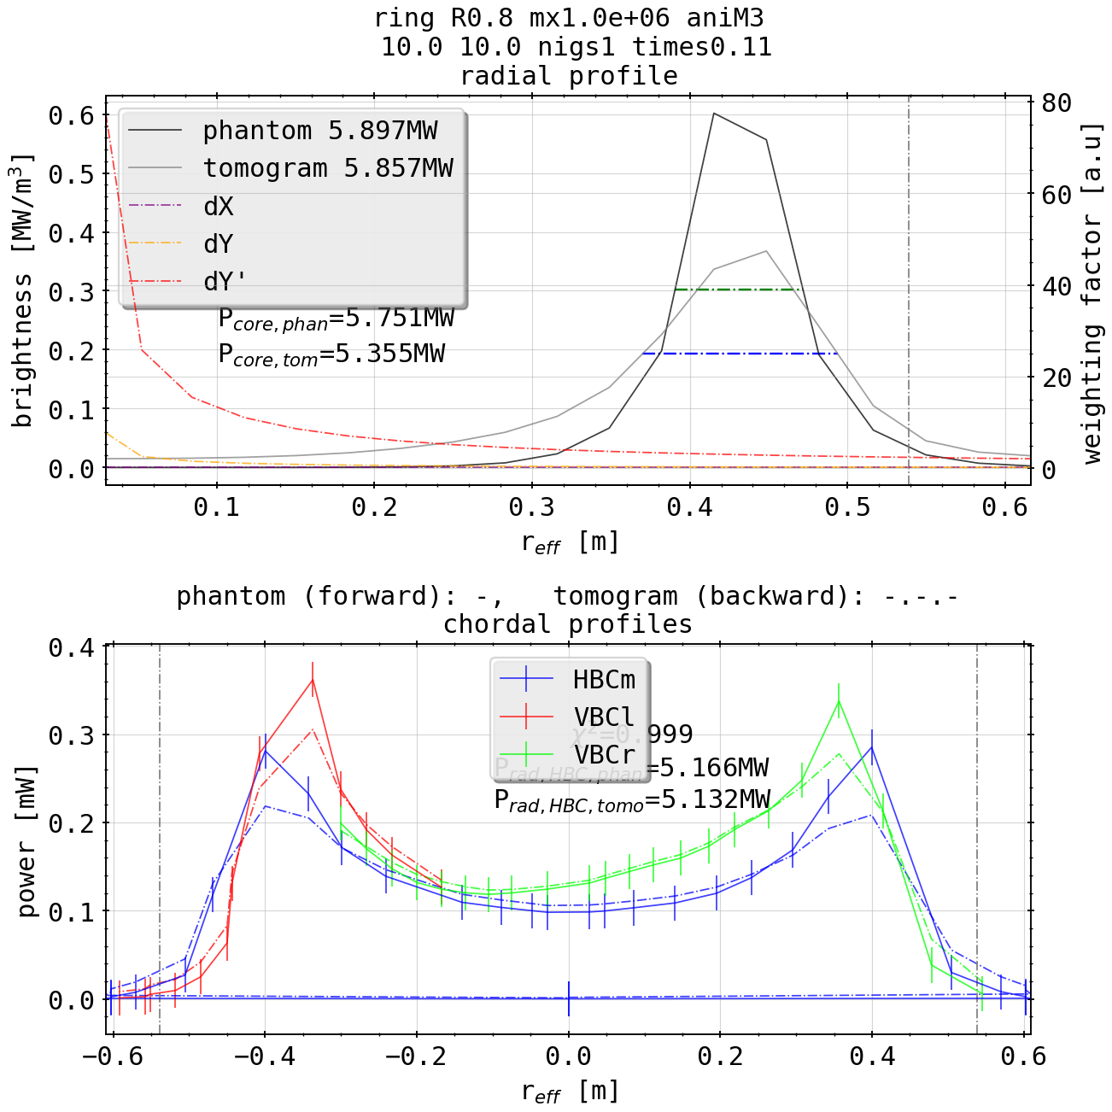
Phantom Test: Single Bright Ring
(phantom)
(tomogram)
good radial match, broader distribution and lower intensity
overall integrated power however equal

Slide 25
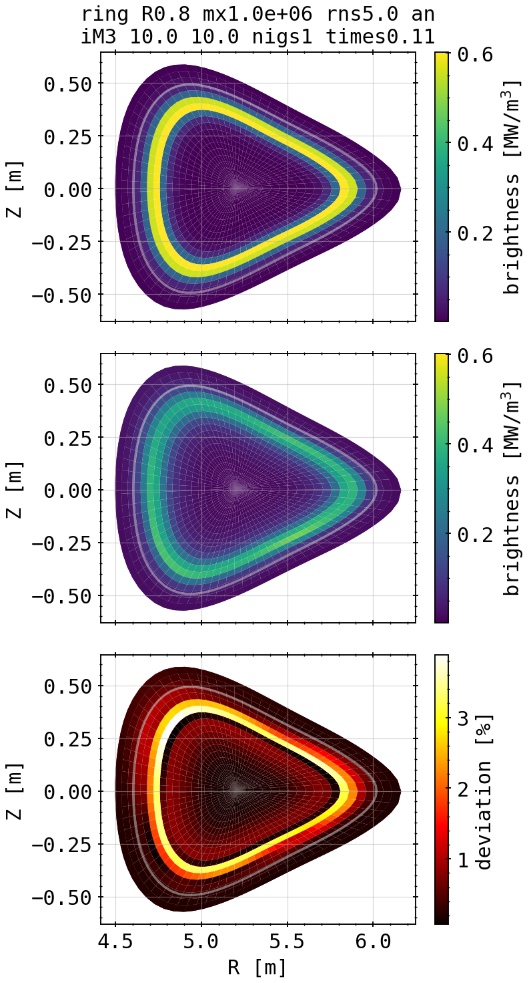
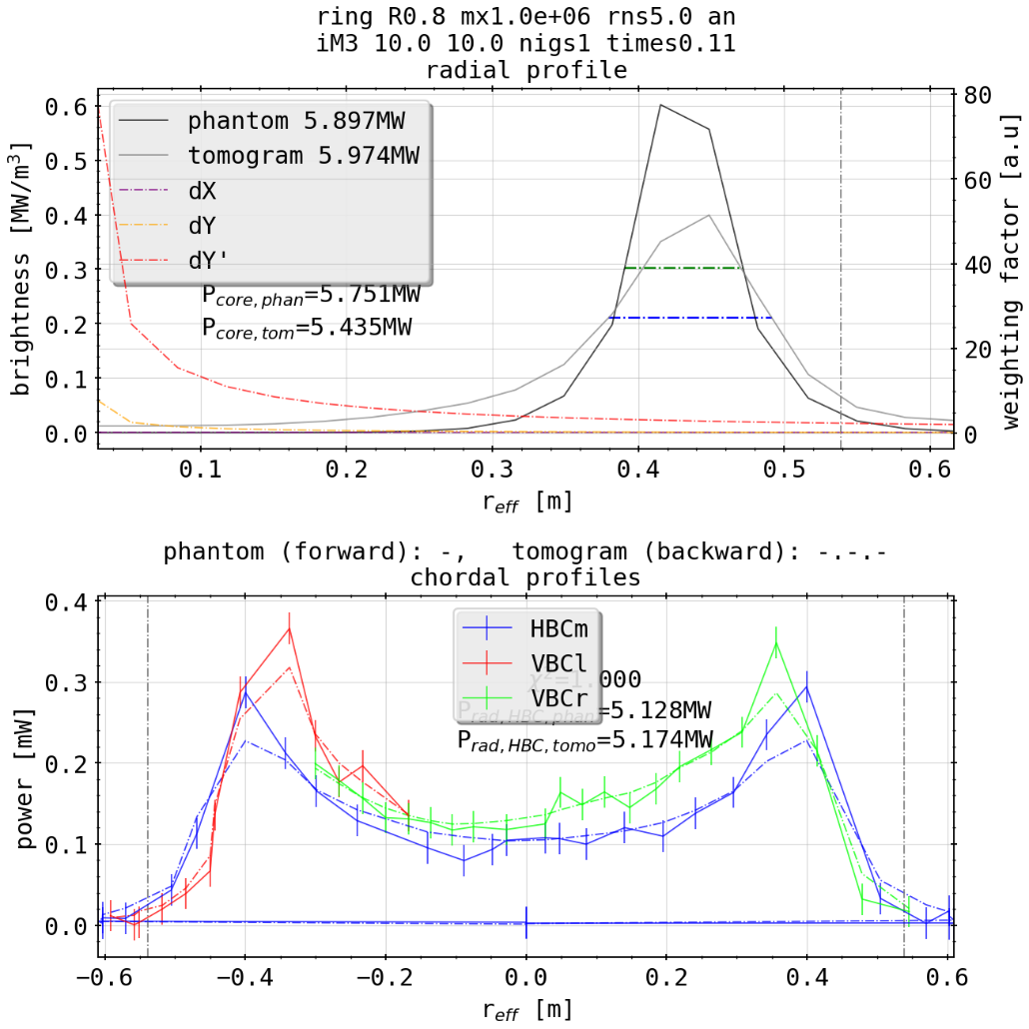
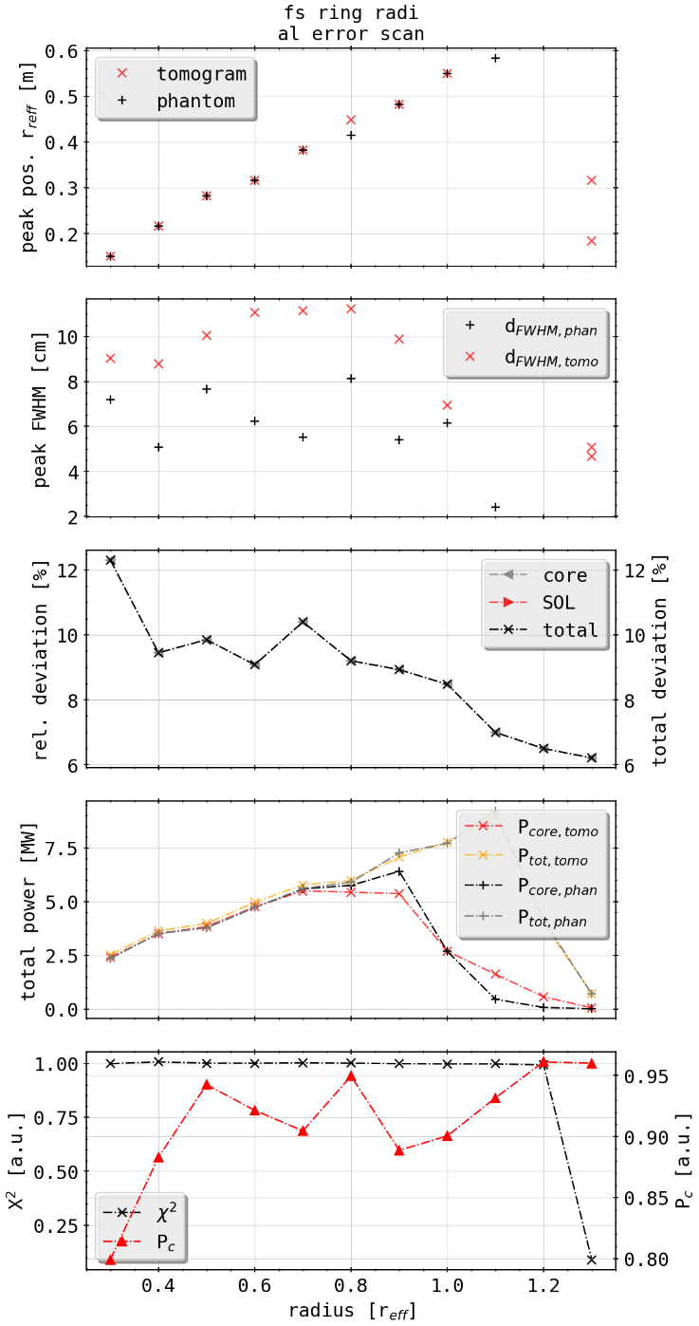
Phantom Test: Single Bright Ring w. 5% error
(phantom)
(tomogram)
same chordal profiles with 5% random error, yields same results
5% error double of measured

Slide 26
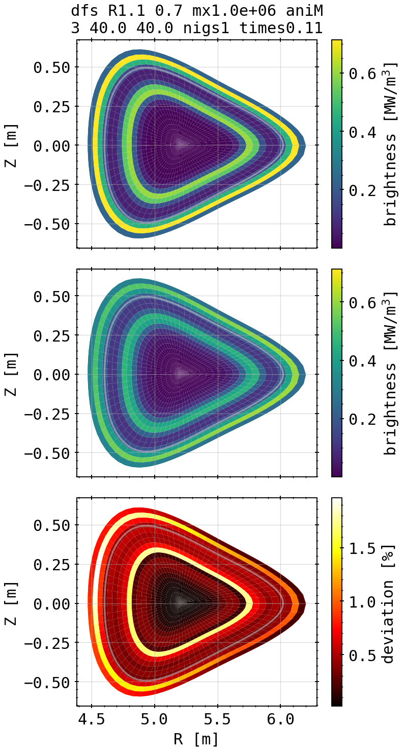
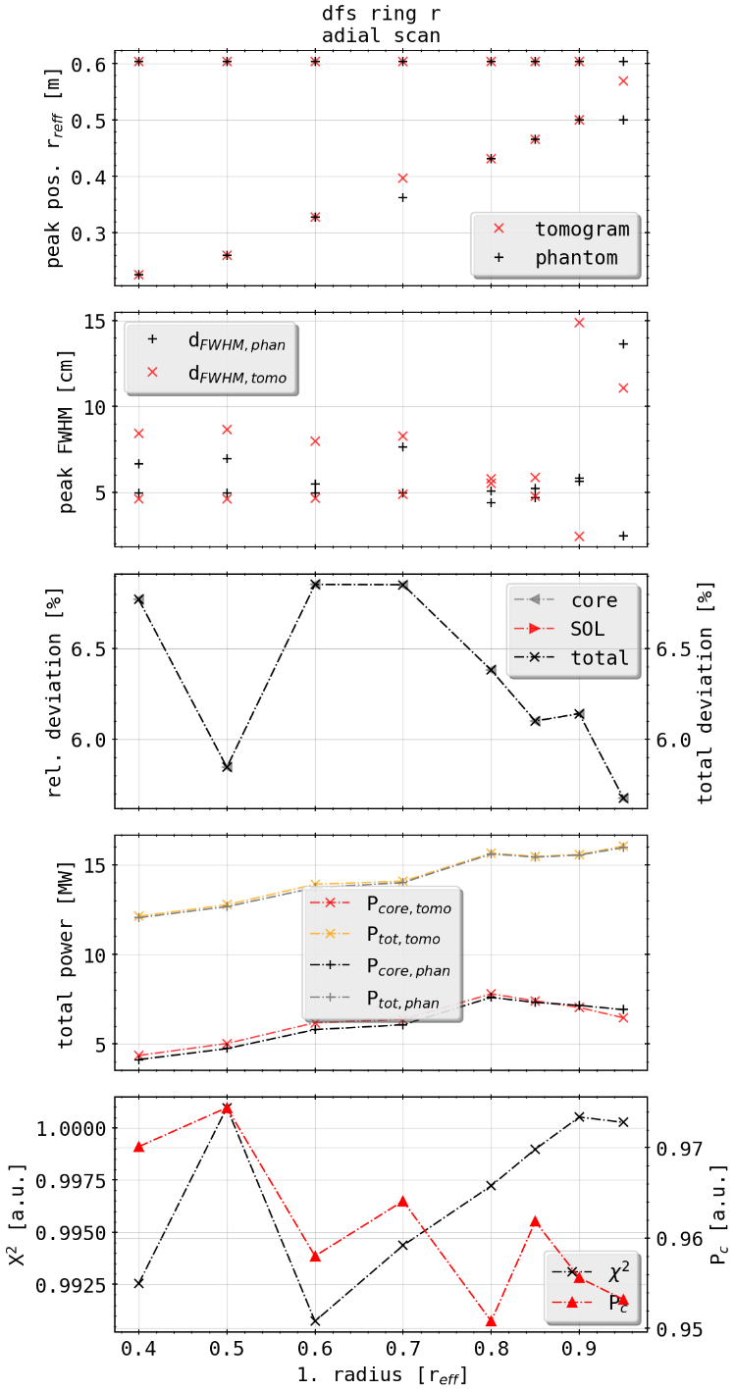
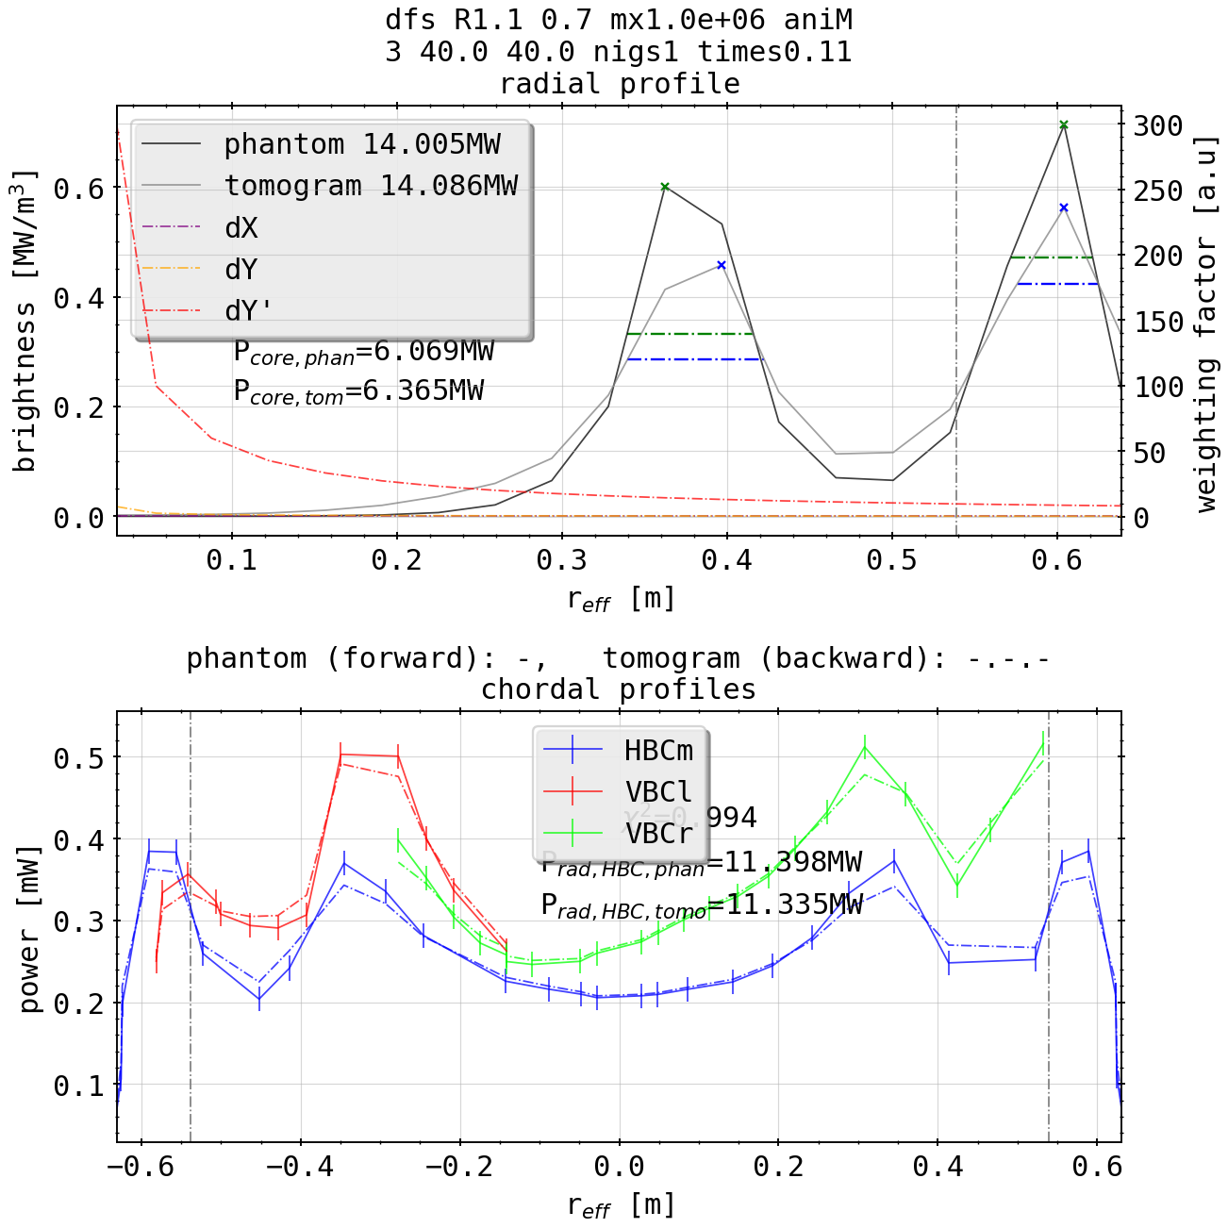
Phantom Test: Double Bright Rings
clear separation of radiation zones, also radial profile

Slide 27
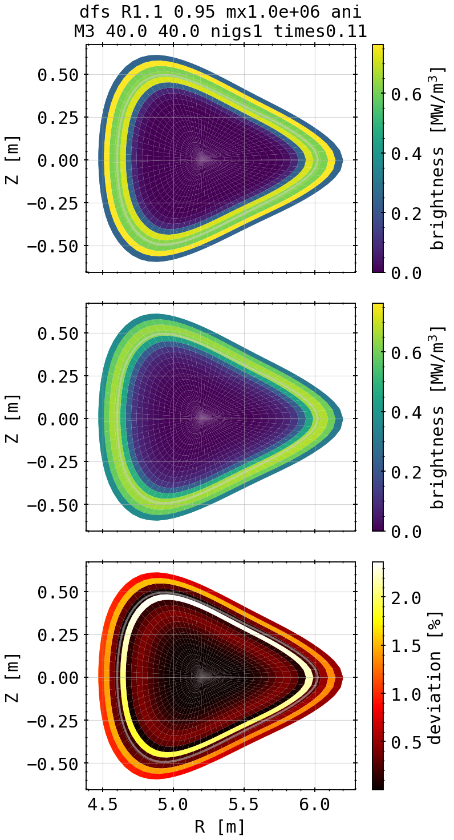
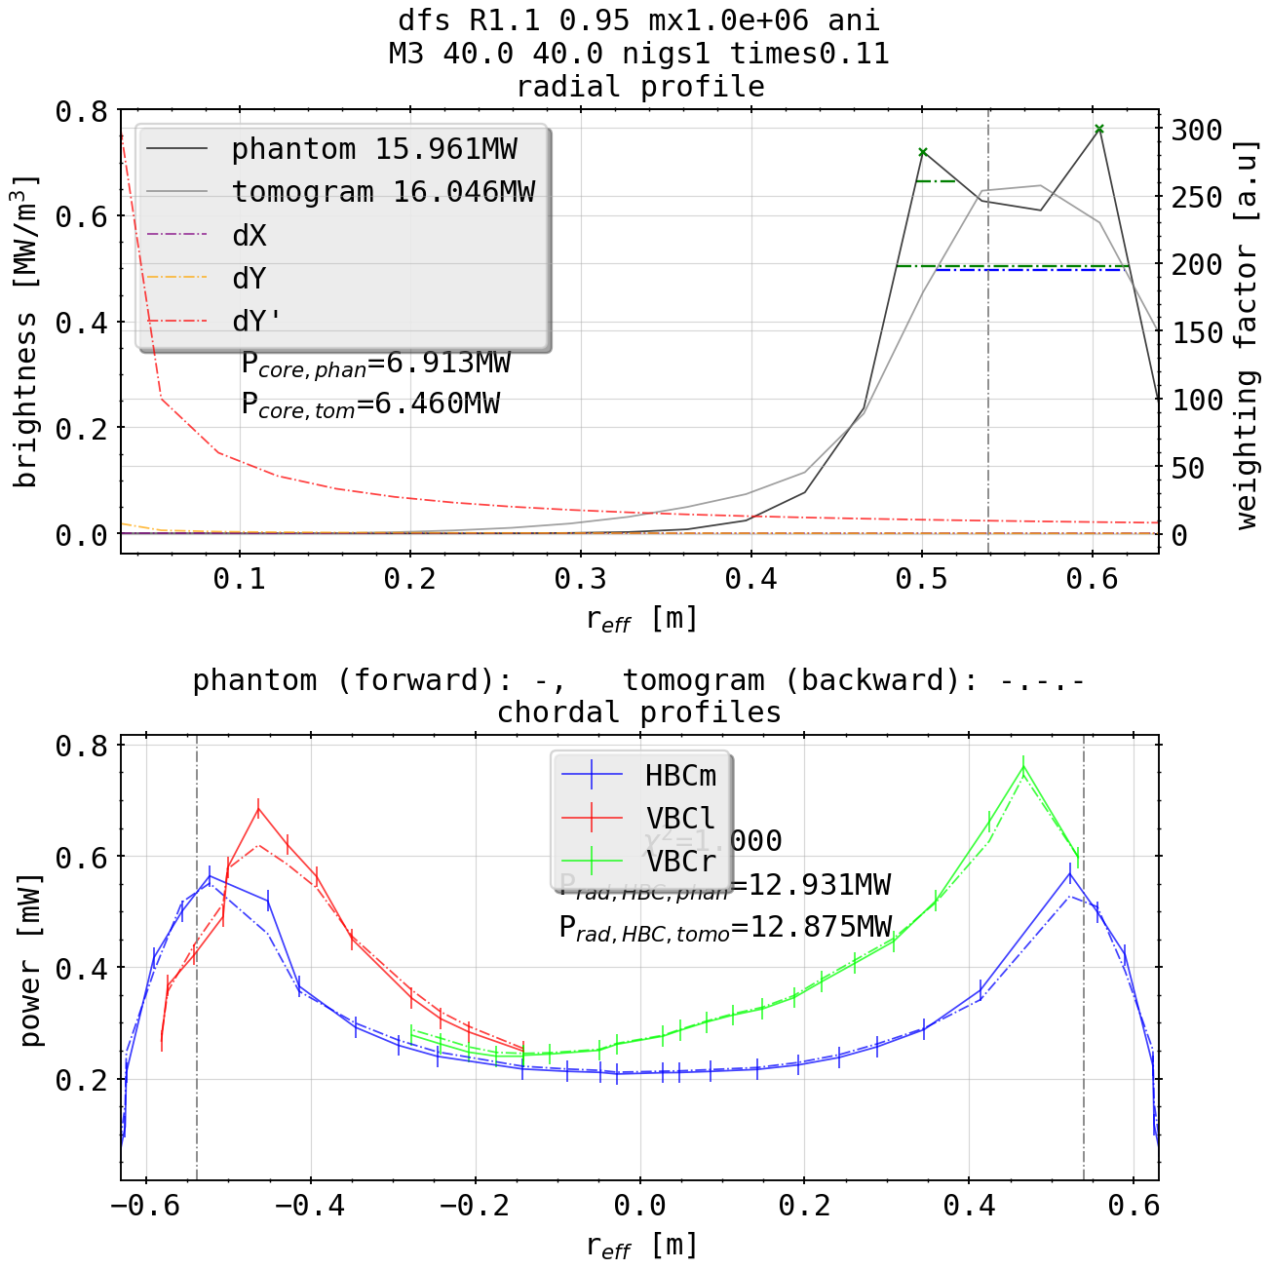
Phantom Test: Double Bright Rings
merging of profiles in reconstruction, minimum resolvable structures approx. >0.15m in radial direction

Slide 28
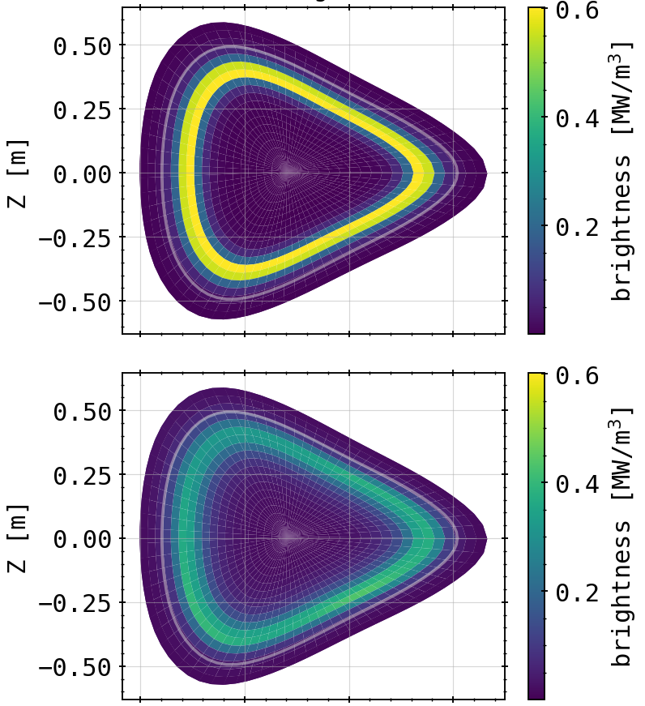

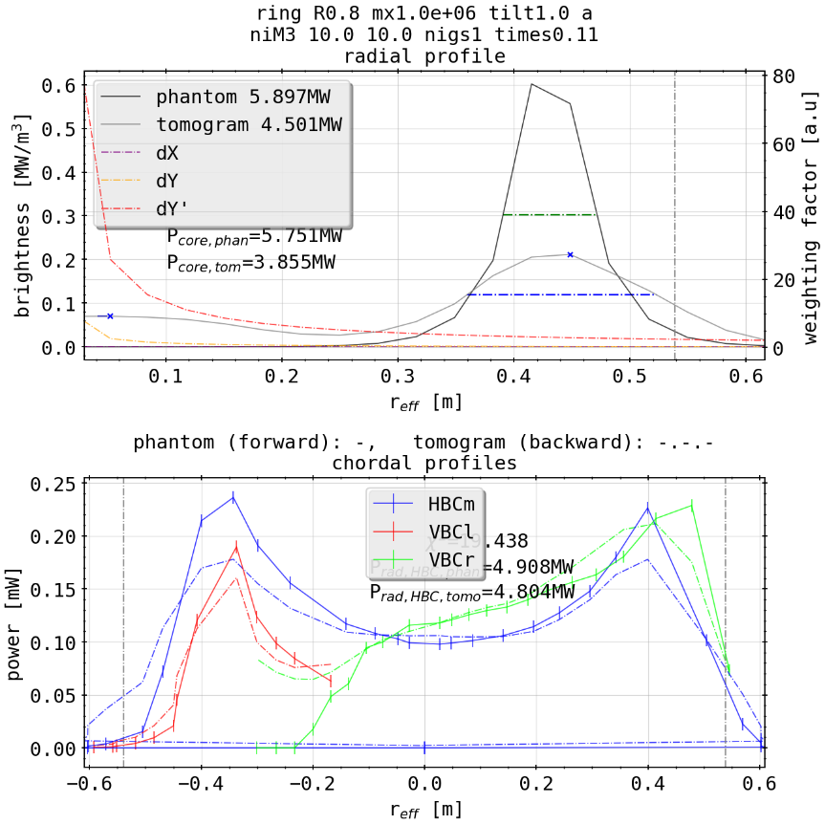
Phantom Test: Bright Ring with Intrinsic Error
Use poloidally rotated camera geometry to calculate forward model and original to do the backward calculations
assuming error measurement of camera position
“TILTED (1.0°)”
“ORIGINAL”

Slide 29
Phantom Test: Bright Ring with Intrinsic Error
reconstruction challenged with unmatching forward and backward emissivity geometries
very large X² indicates conflict in input data, reconstruction however similar
“TILTED (1.0°)”
“ORIGINAL”

Slide 30
Phantom Test: Bright Ring with Intrinsic Error
integrated and extrapolated powers diverge from each other as profiles do not fit
behaviour to be expected if line of sight geometry is disturbed by plasma vessel distortions
“TILTED (1.0°)”
“ORIGINAL”

Slide 31
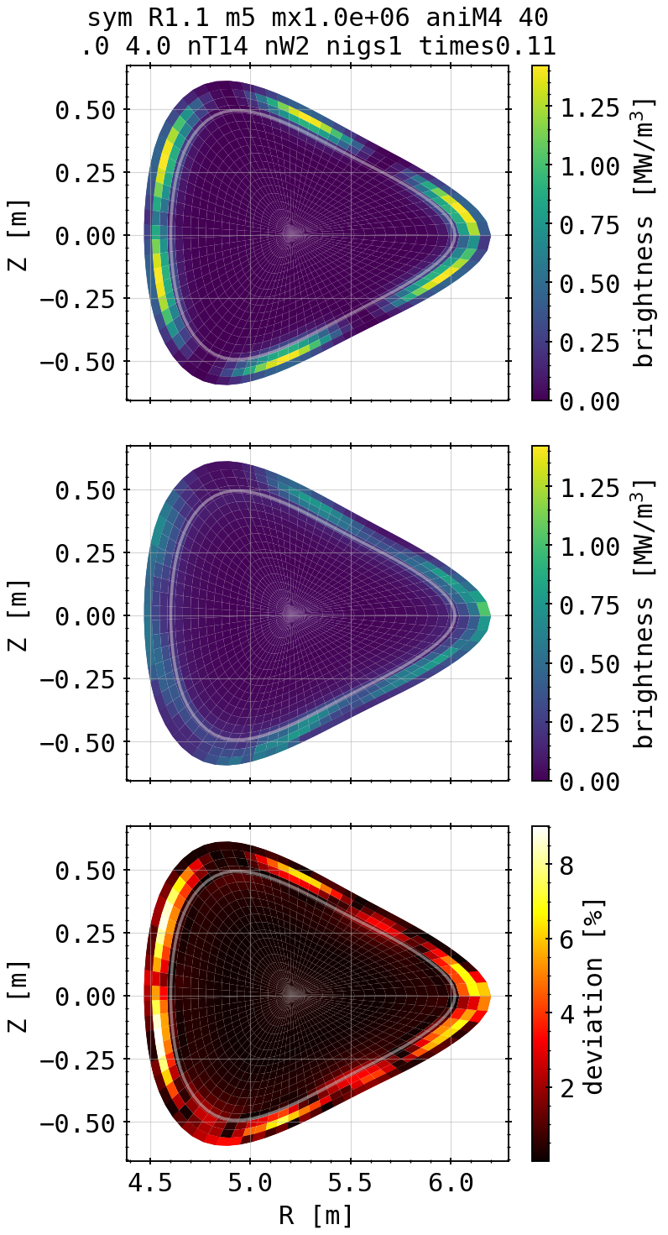
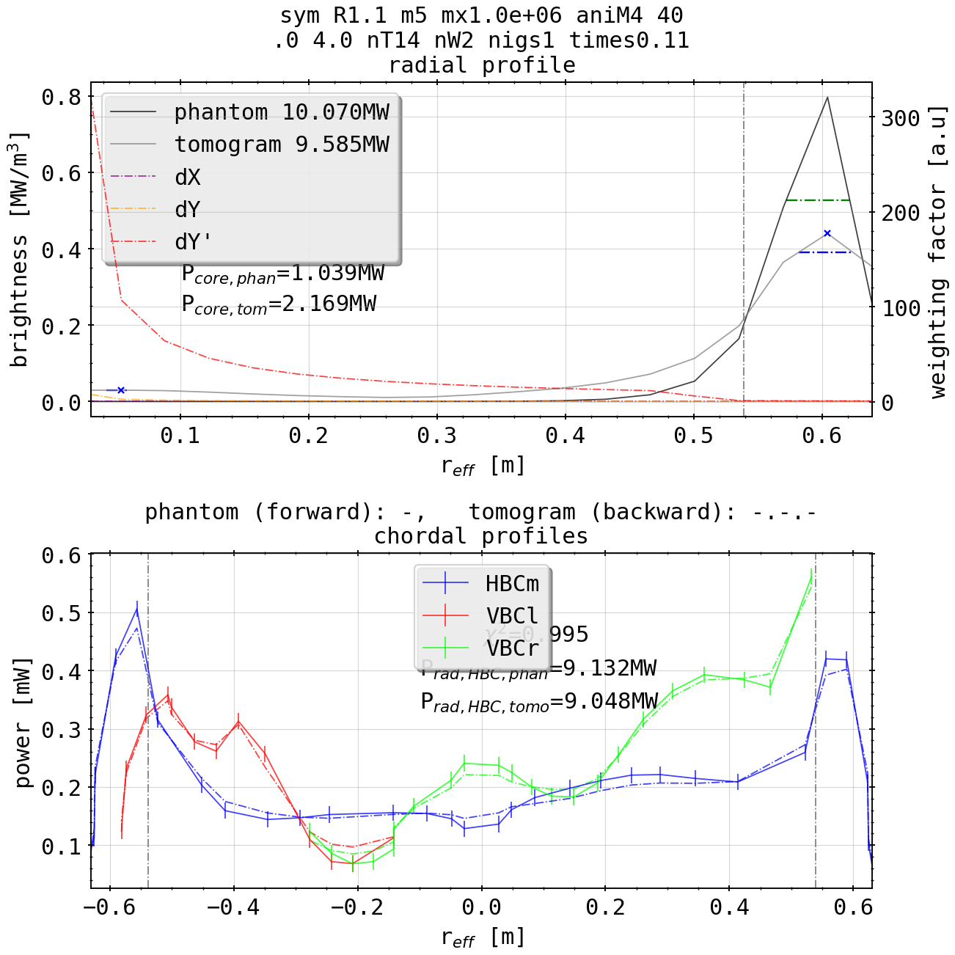
Phantom Test: Symmetric Island Mimic (mode = 5)
imitating 5 fold island chain around confinement area
relatively good match, both radially and poloidally
redeposition of emissivity at center outboard side where line of sight density is highest
in contrast: worse resolution of islands on inboard side

Slide 32
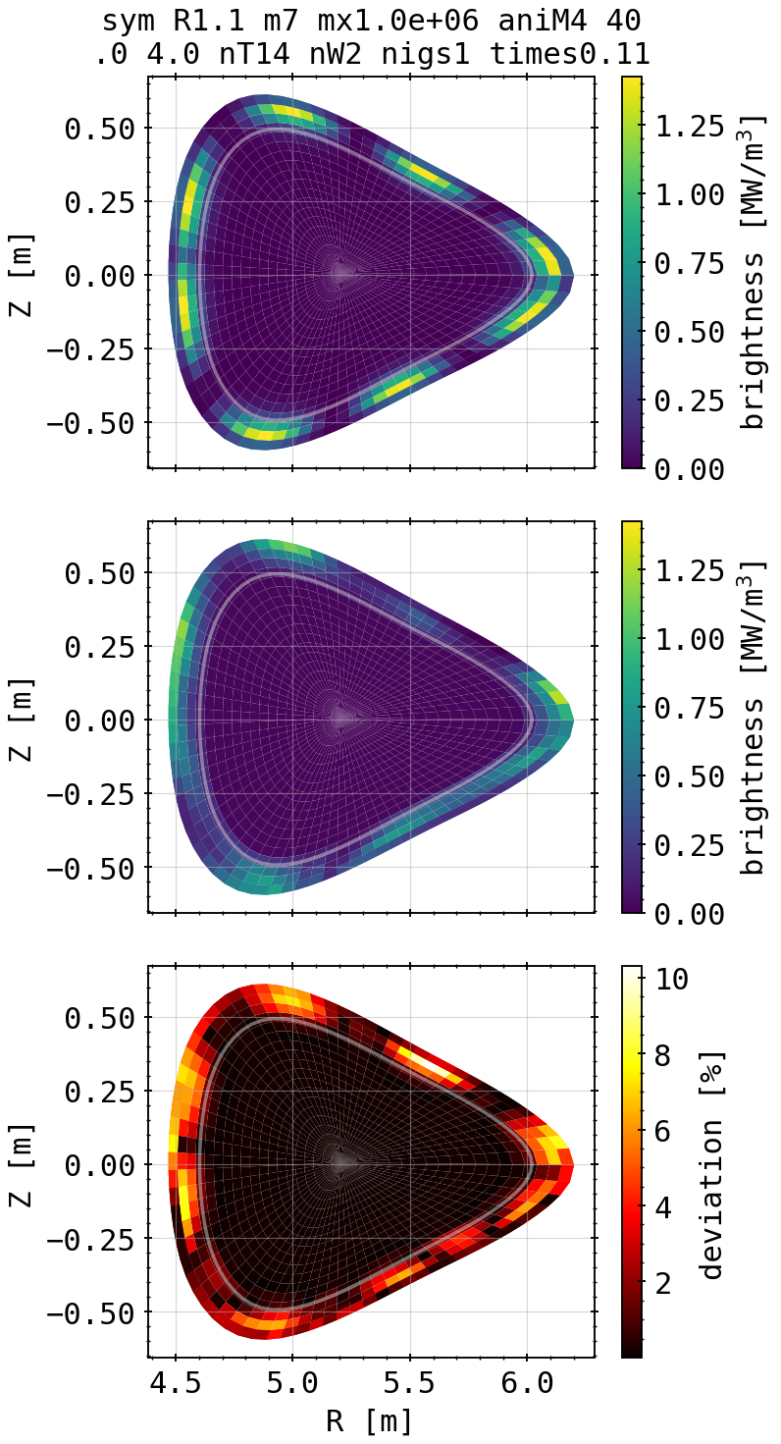
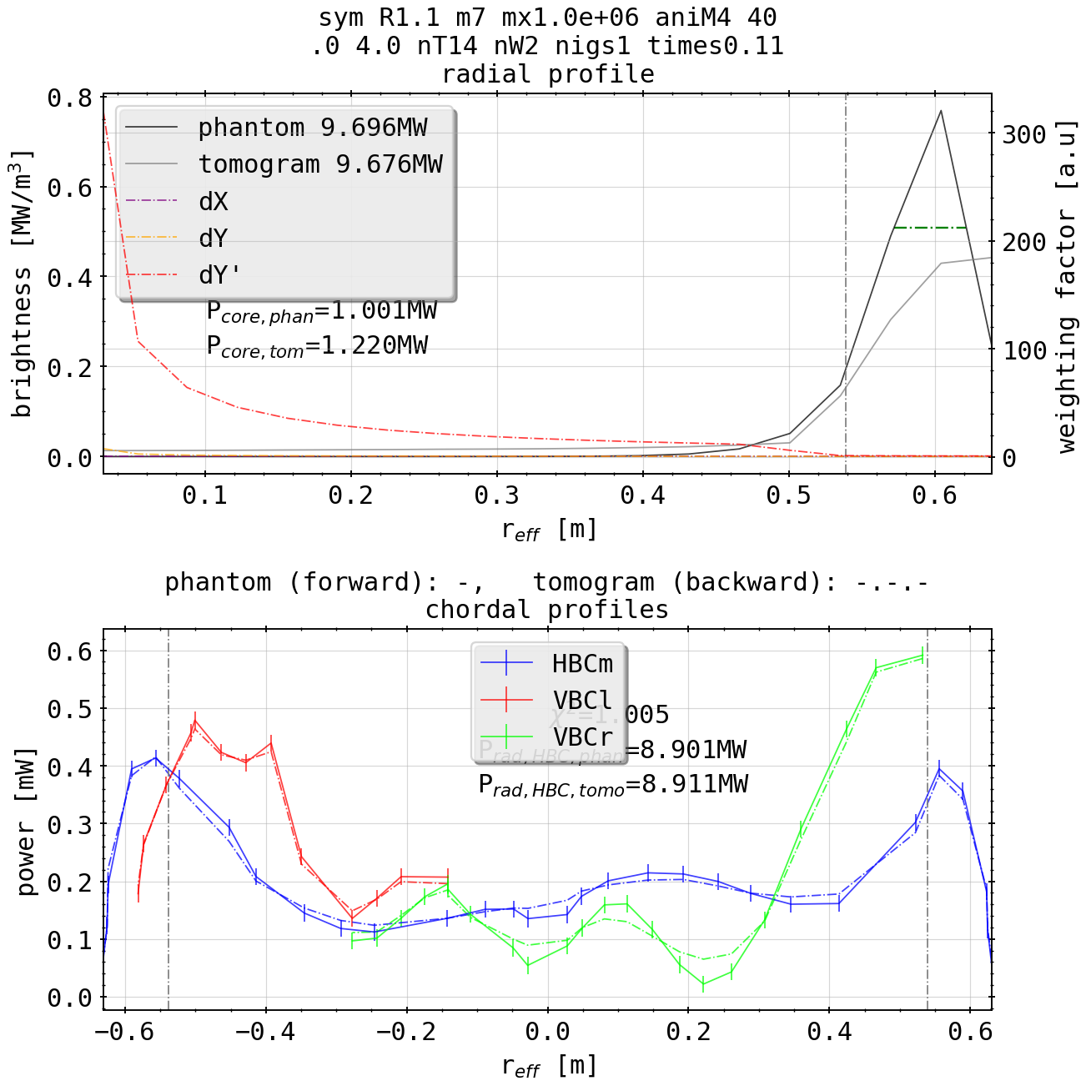
Phantom Test: Symmetric Island Mimic (mode = 7)
artificial 7 fold island
again good match overall
stronger anisotropy between individual islands in intensity
depending on number, single spots might be overshadowed by others with respect to the tangential lines of sight from HBC/VBC

Slide 33
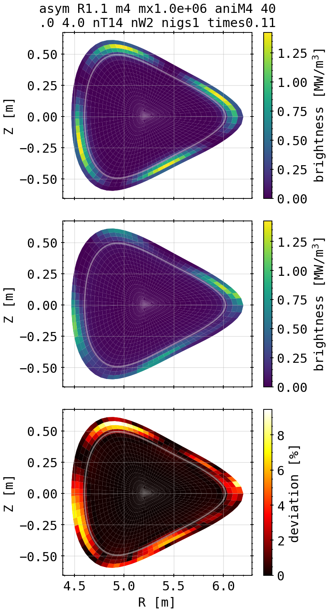
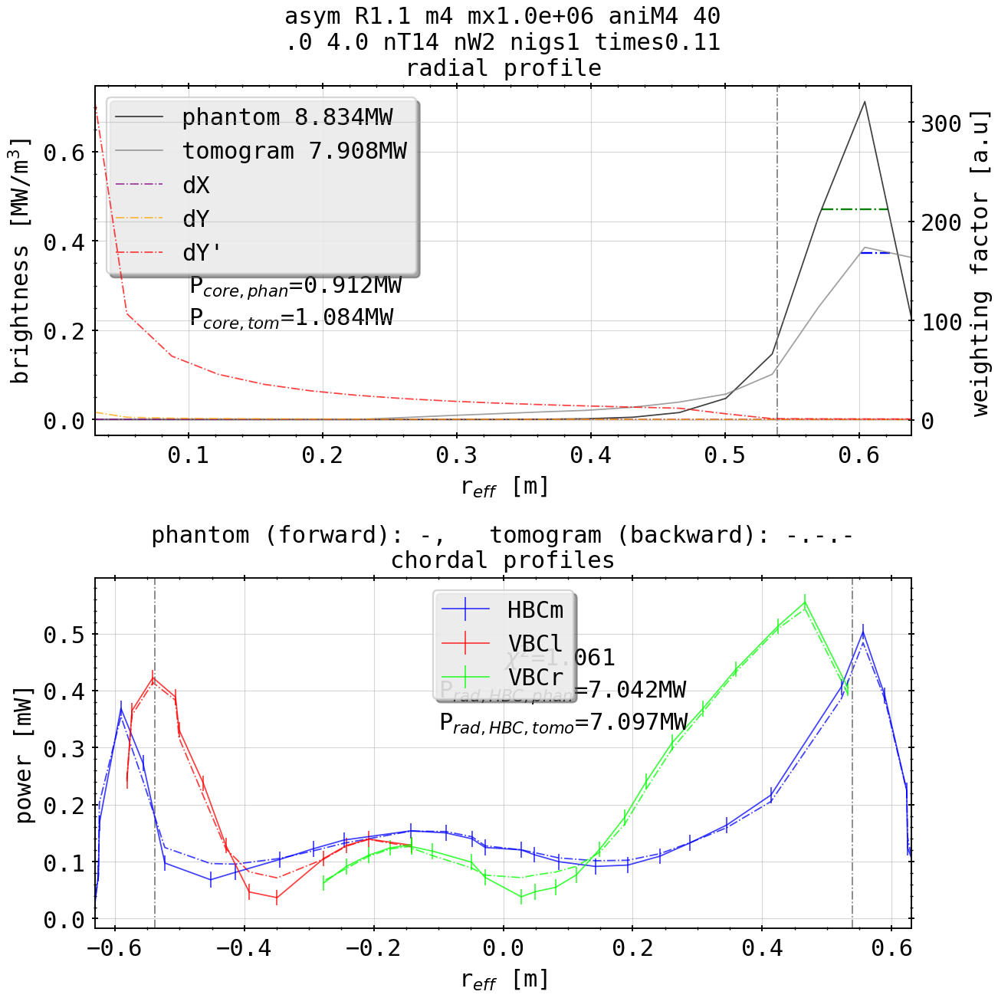
Phantom Test: Asymmetric Island Mimic (mode = 4)
artificial 4 fold islands sinusoidally distributed around core
match as before, profile reconstruction easily readable
overshadowing from outboard island represents issue with line integration along the SOL from both camera arrays

Slide 34
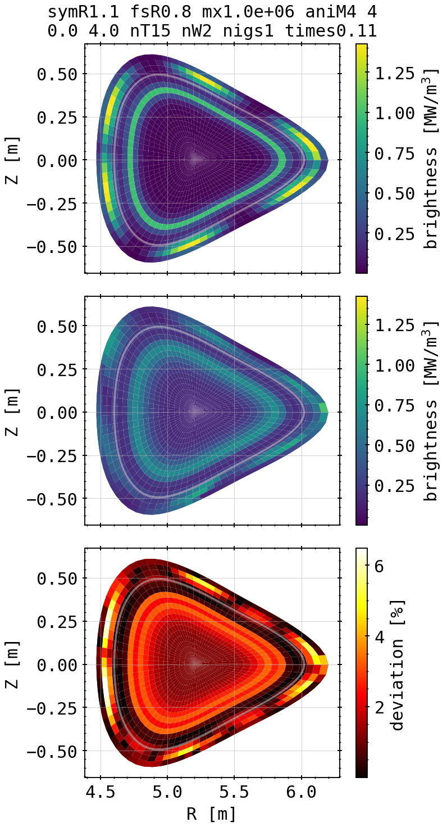
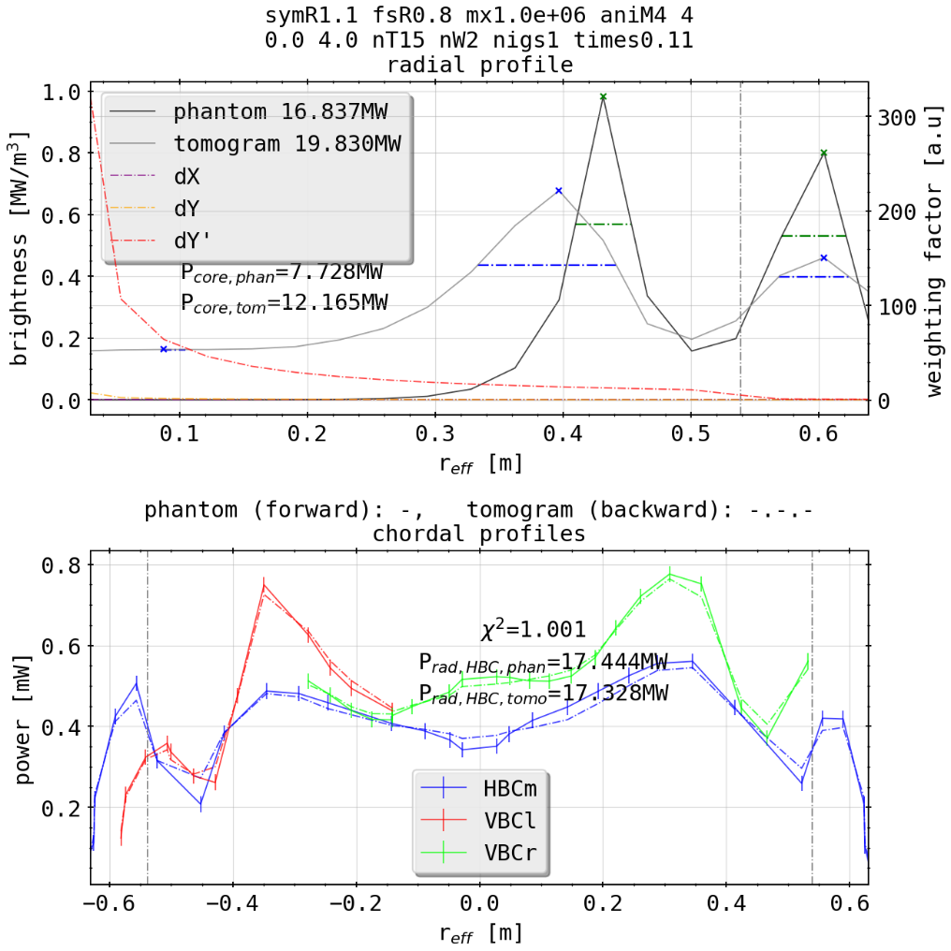
Phantom Test: Island Mimic and Core Radiation
additional profile on the inside of the island mimic does not deteriorate the quality of the spot reconstruction
2D integrated power diverges, however P_rad from chordal profiles is in agreement
smearing effect observed before creates issues when multiple surrogate structures meet

Slide 35
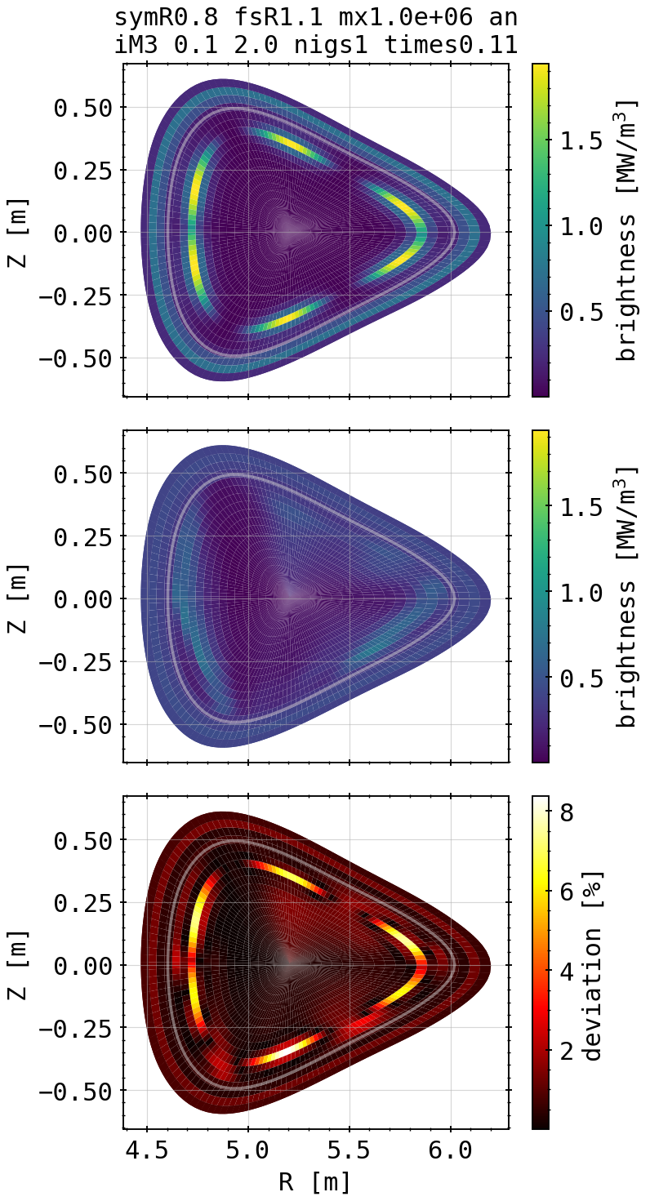
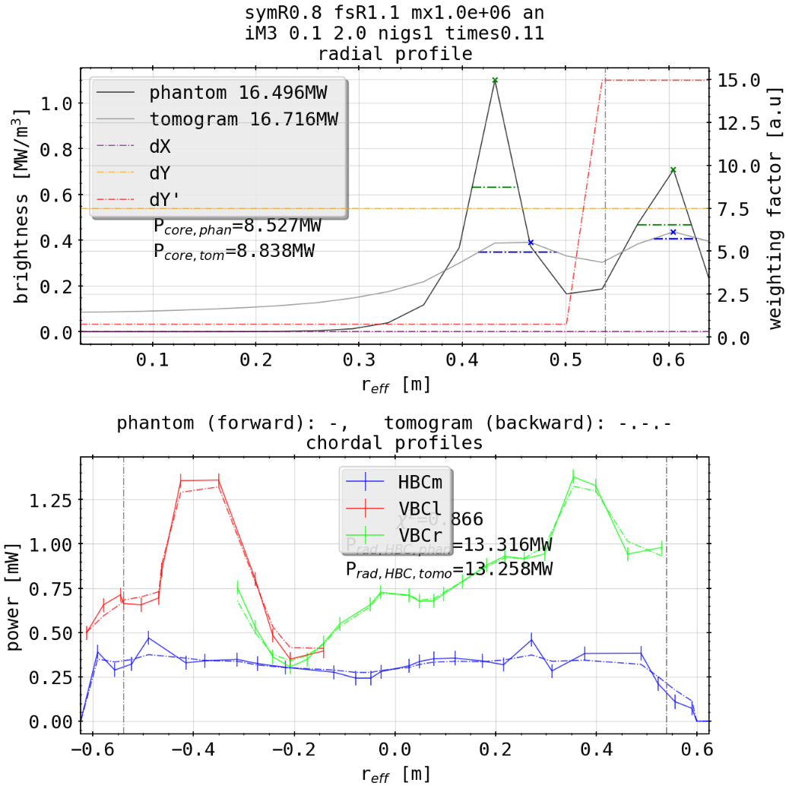
Phantom Test: Island Mimic and Core Radiation
additional profile on the outside of the island mimic does deteriorate the quality of the spot reconstruction
2D integrated power fits, however P_rad from chordal profiles is in agreement
poloidal structure smeared out until being unrecognizable

Slide 36



Phantom Test: New Cameras Towards Island Mimic
adding camera, 15 channels
ARTm
better island positioning and relative intensity, symmetry increased overall
overshadowing persistent from HBC perspective

Slide 37




STRAHL and XP: 20181010.032 Comparison
radiation fraction = 33%
(phantom)
(experiment)
(20181010.032)
STRAHL
(tomogram)

Slide 38




STRAHL and XP: 20181010.032 Comparison
radiation fraction = 66%
(phantom)
STRAHL
(tomogram)

Slide 39




STRAHL and XP: 20181010.032 Comparison
radiation fraction = 90%
(phantom)
STRAHL
(tomogram)

Slide 40




STRAHL and XP: 20181010.032 Comparison
radiation fraction = 100%
(phantom)
STRAHL
(tomogram)

Slide 41


XP: 20181010.032

Slide 42


XP: 20180725.022

Slide 43
Preliminary Conclusion and Outlook
likely good (best?) resolution of inversion domain, both with reasonable accuracy and calculation time is 20x75 cells (radial times poloidal)
additional radial or poloidal points only add time to calculation and possible free parameters to fit emissivity (avoidable by changing the gradients along the aforementioned dimensions accordingly)

Slide 44
Preliminary Conclusion and Outlook
considering a given emissivity profile shape, there exists an ideal set of K factors constraining the ratio of poloidal and radial gradients according to the X² optimisation
not necessarily the same as defined by the lowest 2D deviation and Pearson coefficient, whose optimisation also yields a set of K factors
radial positioning of profiles is subject to the selection of K factors over the radius (and angular space)

Slide 45
Preliminary Conclusion and Outlook
poloidaly distributed profiles are, so far the data set suggests, the hardest to reconstruct properly (especially on the inboard side)
asymmetric characteristics can be property of the underlying emissivity profile to the tomography, however some are introduced due to the line of sight geometry
combinations of profile shapes, especially poloidaly symmetric and any else become hard to distinguish from one another (see ring and island mimic)

Slide 46
Preliminary Conclusion and Outlook
bright spots on-/off-axis and, e.g. bright rings can be separated from each other depending on the distance
individual bright sheaths can no longer be reconstructed radially when closer than 0.2m
reconstructions of forward calculated STRAHL simulations are largely accurate in position and value
reference XP 20181010.032 difficult to reconstruct, subject to difference in forward and backward model?

Slide 47
Preliminary Conclusion and Outlook
possibly find better approach to K factor profile shape for island mimics or combinations (double rings as well?) and asymmetric phantoms
check orders of magnitude/units of results for plausibility

Slide 48
Agenda Review
Completed or Closed
correlation analysis for channel selection
find best channel/selection or combination of channels from any camera to suit the total radiated power loss the best (limited to one-three single experiments/discharges)
interpretation in tandem with improved Thomson scattering profiles from Minerva and impurity content radiation/oxygen
analyse localisation of impurity seeding and hence radiation position/sensitivity of QSB; transport comparison/analysis with STRAHL
TOMOGRAPHY
implementation of findings from channel correlation to inversion, see whether the amount or channel distribution/geometry is efficient

Slide 49
Agenda Review
Uncompleted or Not Started
thermal gas beam feedback is arranged on n_e , not P_rad in those two discharges
→ n_e + ∆n_e ⇒ P_rad + ∆P_rad, need to look at ∆N H2 ?
finish RSI paper scrap with images, graphs, references
comparison between different methods, e.g Minerva/minimum Fischer regularization etc.
investigate on the different impact of extrinsic impurity seedings from thermal gas beam injection (QSQ)
set up database to maybe find common/individual scaling laws in tandem with
relation to n_e , W_dia, P_ECRH etc.

Slide 51



Scans from 2D Results

Slide 52




Scans from 2D Results

Slide 53













Revisited: Test of 20180725.044
KJM magnetic configuration
chordal profile HBCm

Slide 54

Revisited: Test of 20180725.044
KJM magnetic configuration
chordal profile HBCm

Slide 55
Revisited: Test of 20180725.044
KJM magnetic configuration
chordal profile HBCm

Slide 56
Revisited: Test of 20180725.044
KJM magnetic configuration
chordal profile HBCm

Slide 57
Revisited: Test of 20180725.044
KJM magnetic configuration
chordal profile HBCm

Slide 58
Revisited: Test of 20180725.044
KJM magnetic configuration
chordal profile HBCm

Slide 59
Revisited: Test of 20180725.044
KJM magnetic configuration
chordal profile HBCm

Slide 60
Revisited: Test of 20180725.044
KJM magnetic configuration
chordal profile HBCm

Slide 61
Revisited: Test of 20180725.044
KJM magnetic configuration
chordal profile HBCm

Slide 62
Revisited: Test of 20180725.044
KJM magnetic configuration
chordal profile HBCm

